Slide 1
Improving Modern Techniques of Causal Inference
Lucy D’Agostino McGowan

Slide 2
Vanderbilt University
Supplementing clinical trials with EHR data
Analyzing data analysis techniques
Data science pedagogy
Johns Hopkins
p-hack-athon
tidycode
TED-Ed
Understanding Data and Statistics in Medical Literature
Causal inference
Multi-reader multi-case ROC curves
VA Health Outcomes
ATO Doubly Robust estimator and Variance estimation
Sensitivity to Unmeasured Confounding
ATM and ATO weights finite sample bias
Notes:
Broadly, I get excited about identifying a large problem in the scientific community and finding a way statistics can help.

Slide 3
Vanderbilt University
Supplementing clinical trials with EHR data
Analyzing data analysis techniques
Data science pedagogy
Johns Hopkins
p-hack-athon
tidycode
TED-Ed
Understanding Data and Statistics in Medical Literature
Causal inference
Multi-reader multi-case ROC curves
VA Health Outcomes
ATO Doubly Robust estimator and Variance estimation
Sensitivity to Unmeasured Confounding
ATM and ATO weights finite sample bias

Slide 4
Background
How do we compensate for non-random treatment assignment?
How do we incorporate the propensity scores?
Sensitivity Analysis
What if our assumptions are violated?
Method
Estimation
How do we calculate these weights?
Which weights should we choose?
How do we estimate the treatment effect?
How do we estimate the variability?
Notes:
Dr. Raynor mentioned that it'd be best for this talk not to be too technical since there would be a broad audience. Going to have some equations for those of you that get excited about understanding precisely what I’ve done, but they will always be paired with a high level explanation along with some fun animations. SO if the equation doesn’t quite make sense, hang on tight for the high level explanation, and if that still doesn’t make sense, please interrupt me, I’m happy to clarify at any point!

Slide 5
Background

Slide 6

Observational Studies
exposure
outcome
Notes:
A lot of my research so far has been in the observational study space. Like many statistical questions, our goal here is to assess the association between some [click] exposure, in my case often a treatment, and some [click] outcome.

Slide 7
Observational Studies
Randomized Controlled Trials
Treatment
P=0.5
Control
P=0.5
Notes:
An observational study is distinct from a [click] randomized controlled trial. A randomized study works something like this [click] a participant is assigned to either the [click] treatment or control group [click] this treatment assignment is via some random process, in the simplest case something like a coin flip. We know the probability of treatment assignment and often patients are just as likely to have been assigned to the treatment group as the control group

Slide 8

Estimate treatment effect
$$\frac{\sum_{i=1}^{n}{Y_{i}Z_{i}}}{\sum_{i=1}^{n}{Z_{i}}}−\frac{\sum_{i=1}^{n}{Y_{i}\left(1−Z_{i}\right)}}{\sum_{i=1}^{n}{(1−Z_{i})}}$$
Notes:
In this randomized setting, we can just take the the difference between the mean outcome among the treated and the mean outcome among the controls. I'm showing this specific notation because we are going to build on it in the subsequent slides.

Slide 9
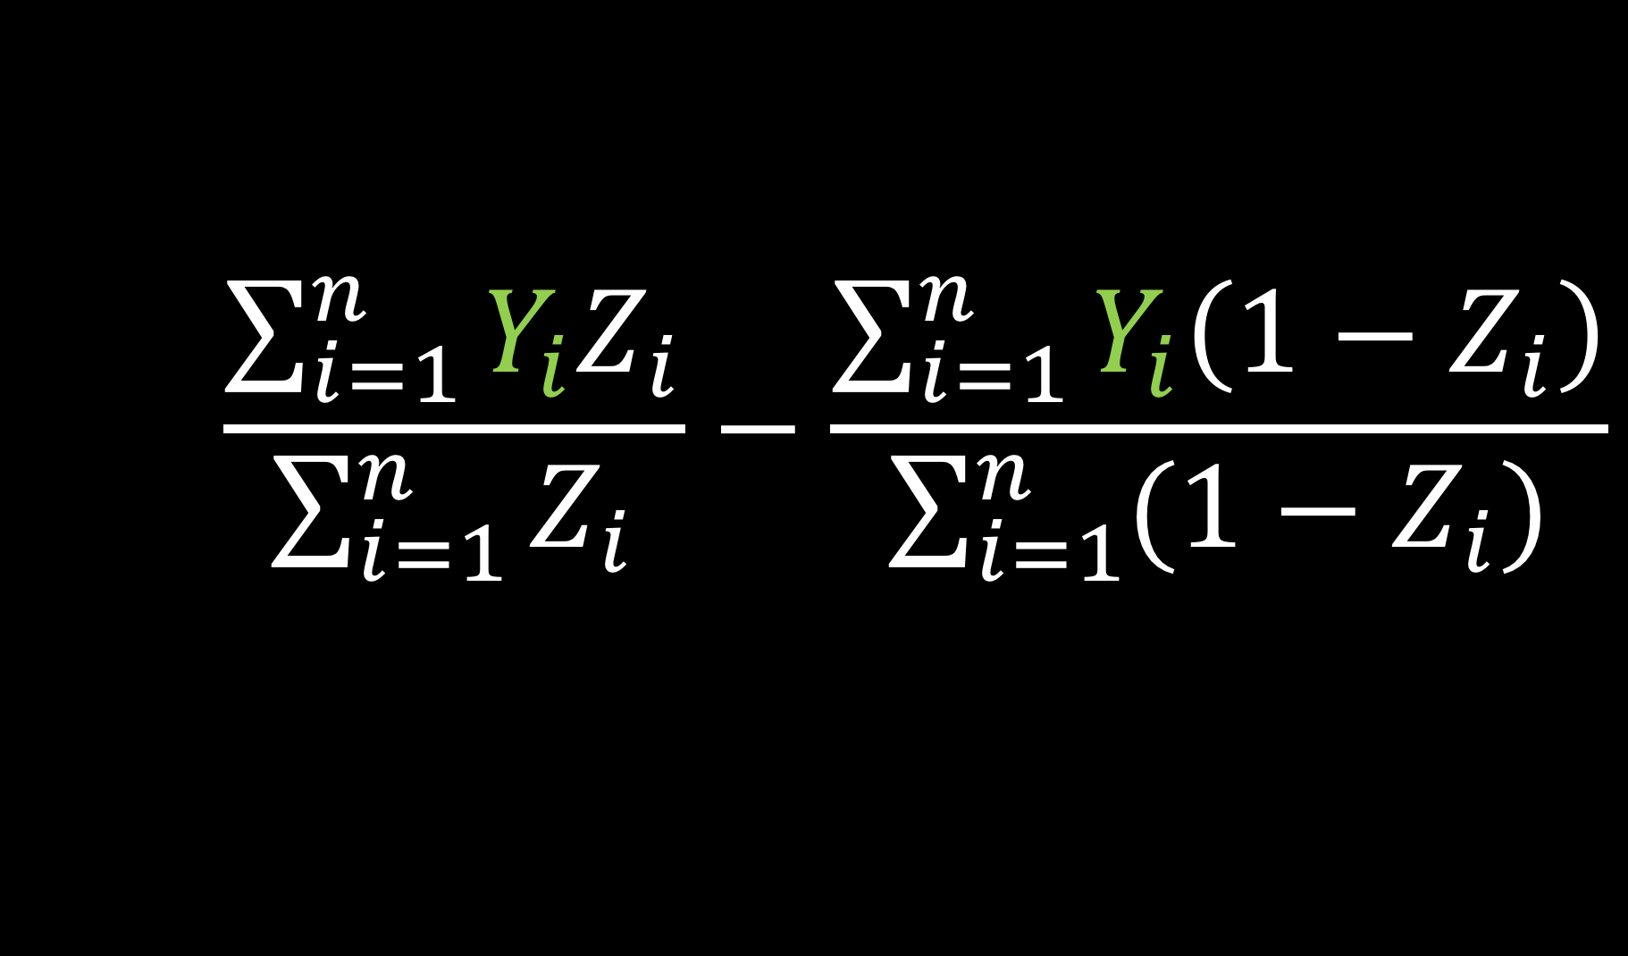
Estimate treatment effect
$$\frac{\sum_{i=1}^{n}{Y_{i}Z_{i}}}{\sum_{i=1}^{n}{Z_{i}}}−\frac{\sum_{i=1}^{n}{Y_{i}\left(1−Z_{i}\right)}}{\sum_{i=1}^{n}{(1−Z_{i})}}$$
Notes:
Yi is the observed outcome for participant i

Slide 10
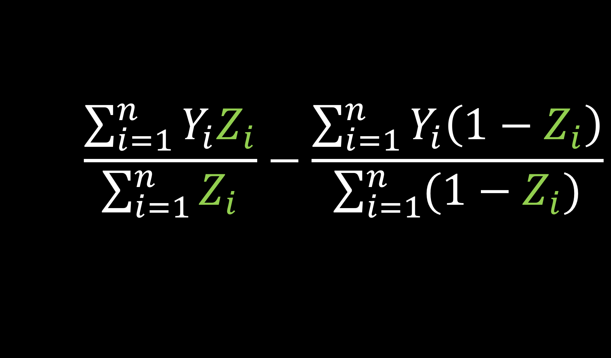
Estimate treatment effect
$$\frac{\sum_{i=1}^{n}{Y_{i}Z_{i}}}{\sum_{i=1}^{n}{Z_{i}}}−\frac{\sum_{i=1}^{n}{Y_{i}\left(1−Z_{i}\right)}}{\sum_{i=1}^{n}{(1−Z_{i})}}$$
Notes:
Zi is the indicator for treatment for participant i (it is 0 or 1)

Slide 11
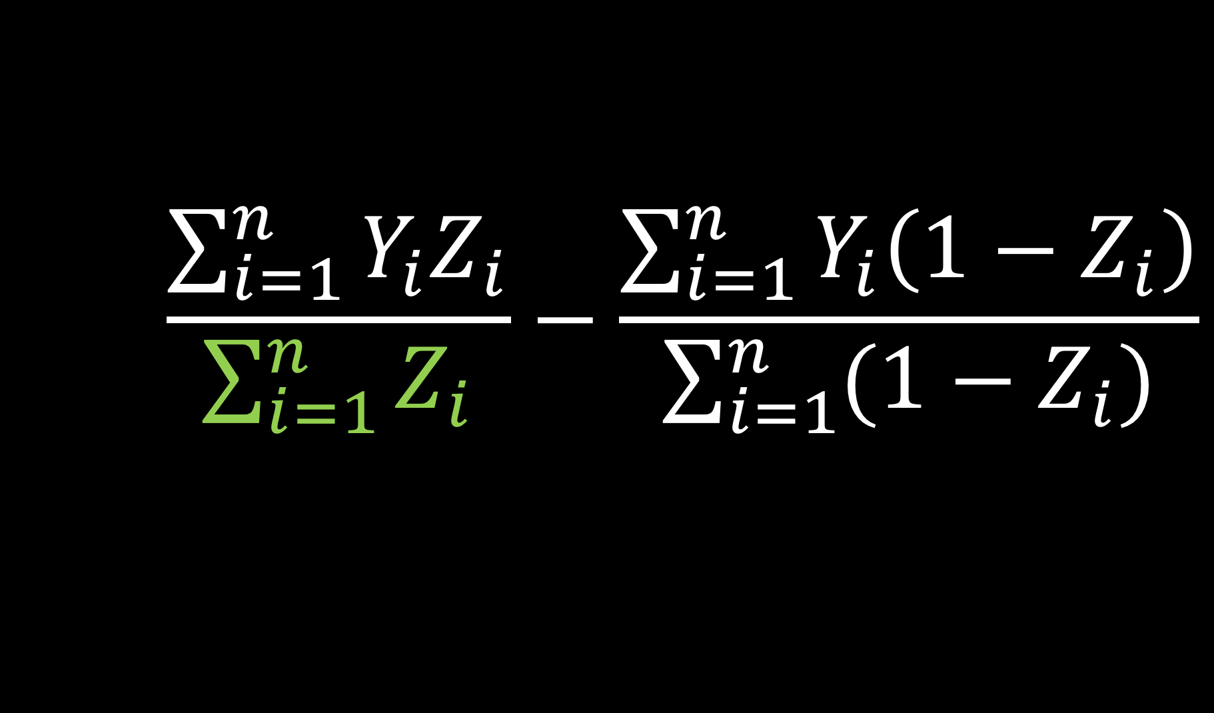
Estimate treatment effect
$$\frac{\sum_{i=1}^{n}{Y_{i}Z_{i}}}{\sum_{i=1}^{n}{Z_{i}}}−\frac{\sum_{i=1}^{n}{Y_{i}\left(1−Z_{i}\right)}}{\sum_{i=1}^{n}{(1−Z_{i})}}$$
Notes:
the denominator of this first portion, the sum of Zi, is just your total number of treated people

Slide 12
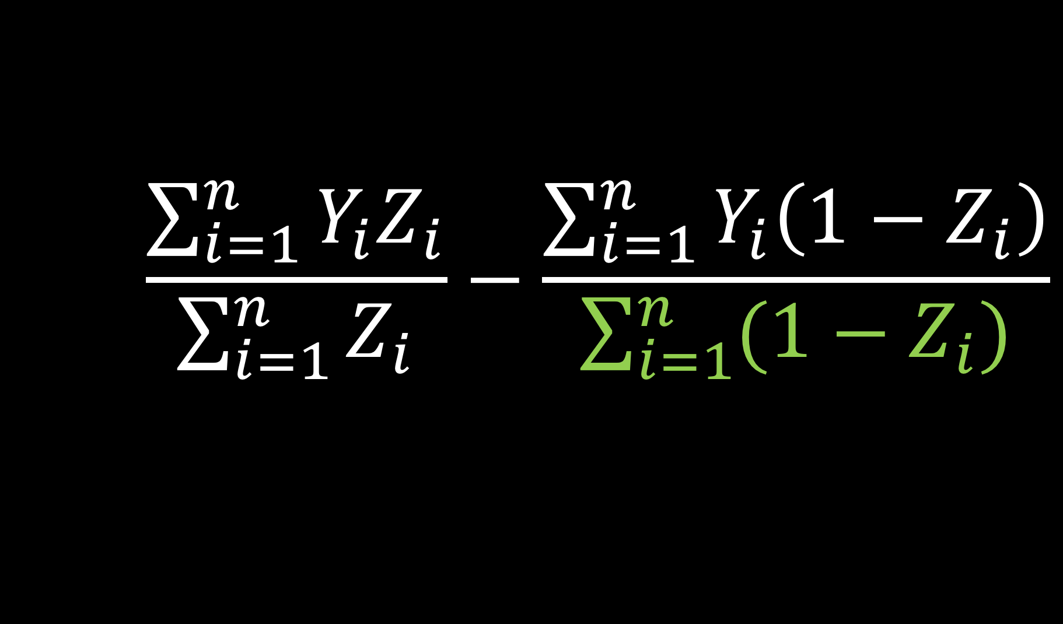
Estimate treatment effect
$$\frac{\sum_{i=1}^{n}{Y_{i}Z_{i}}}{\sum_{i=1}^{n}{Z_{i}}}−\frac{\sum_{i=1}^{n}{Y_{i}\left(1−Z_{i}\right)}}{\sum_{i=1}^{n}{(1−Z_{i})}}$$
Notes:
sum of (1-Zi) is your total number of controls

Slide 13
Observational Studies
Treatment
P=0.9
Control
P=0.1
Notes:
An observational study differs from a randomized study in that now instead of a random process such as a coin flip determining your treatment assignment, the treatment assignment [click] is determined by something else, for example your doctor. We may still be able to calculate [click] the probability that you were assigned to the treatment group, but it is no longer random. For example, one study I worked on looked at two different diabetes drugs and their association with heart disease. Instead of conducting a randomized trial, we looked at EHR data to see which treatment patients were given and then examined their subsequent heart disease. It turns out one of the drugs was more likely to be prescribed to sicker patients. If we didn't account for this, we would end up with a biased result, it could look like that drug led to more heart disease when in reality this might have been driven by the patients pre-treatment characteristics.

Slide 14
How do we compensate for non-random treatment assignment?
Notes:
This brings me to our first question. How do we compensate for non-random treatment assignment?

Slide 15

Propensity score
$$e_{i}=P(Z_{i}=1|X)$$
Notes:
One way to do this is via propensity scores. The propensity score is denoted here as ei. It is the probability that you received treatment given your observed pre-treatment covariates, here denoted as x. A lot of times we fit this with a logistic regression

Slide 16
Propensity scores
Rosenbaum and Rubin showed in observational studies, conditioning on propensity scores can lead to unbiased estimates of the treatment effect
There are no unmeasured confounders
Every subject has a nonzero probability of receiving either treatment
Notes:
Propensity scores can give unbiased estimates of the treatment effect as long as [click] there are no unmeasured confounders - that is you account for all of the pre-treatment characteristics that are associated with both the exposure and the outcome and [click] Every subject has a non-zero probability of receiving either treatment. In other words, you don't want the propensity score to be exactly 0 or 1.

Slide 17
Propensity scores
Rosenbaum and Rubin showed in observational studies, conditioning on propensity scores can lead to unbiased estimates of the treatment effect
There are no unmeasured confounders
Every subject has a nonzero probability of receiving either treatment
Notes:
This first condition is essentially impossible to check, however sensitivity analysis can be conducted to measure the impact of an unmeasured confounder. The final section of this talk will address some research I have done in this area.

Slide 18

Propensity scores
Notes:
Alright so I've shown how that works mathematically, let's take a second to see it visually. Here I have two sets of participants. On the left, in my purple group I have participants that were given the treatment. On the right, my green group, I have participants given the control. Notice these participants all have various combinations of pre-treatment characteristics. For example, some are wearing cowboy hats, some smokers, some have healthy hearts, and some are mustachioed.

Slide 19
Propensity scores
0.9
0.2
0.1
0.3
0.7
0.3
0.1
0.6
0.6
0.9
0.2
0.2
0.3
0.1
0.1
0.8
0.7
0.7
0.8
0.2
0.2
Notes:
Using these pre-treatment characteristics, I can calculate the probability that these participants would have received treatment [click], and assign each their propensity score

Slide 20
✓
How do we compensate for non-random treatment assignment?
propensity scores
Notes:
So that answers our first question, we compensate for non-random treatment assignment with propensity scores.

Slide 21
✓
How do we compensate for non-random treatment assignment?
propensity scores
How do we incorporate the propensity scores?
Notes:
Now that we've decided to use the propensity score, how do we incorporate it in our analysis?

Slide 22
Propensity scores
0.9
0.2
0.1
0.3
0.7
0.3
0.1
0.6
0.6
0.9
0.2
0.2
0.3
0.1
0.1
0.8
0.7
0.7
0.8
0.2
0.2
Notes:
There are lots of ways to incorporate propensity scores, but two that I prefer are matching and weighting. This is because both of these methods make it very straightforward to describe the characteristics of the study population

Slide 23
Propensity scores
0.9
0.2
0.1
0.3
0.7
0.3
0.1
0.6
0.6
0.6
0.9
0.2
0.2
0.3
0.1
0.1
0.1
0.7
0.7
0.8
0.7
0.2
0.8
0.2
0.8
0.2
0.2
Notes:
In matching, we often drop some patients that don't have a good match in the opposite group

Slide 24
Propensity scores
0.9
0.2
0.1
0.3
0.6
0.6
0.9
0.2
0.3
0.1
0.8
0.7
0.7
0.8
0.2
0.2
Notes:
And then line up the remaining patients, here the top patients were assigned treatment, and the bottom control

Slide 25
Propensity scores
0.2
0.2
0.3
0.6
0.7
0.8
0.9
0.1
0.1
0.2
0.2
0.3
0.6
0.7
0.8
0.9
Notes:
We can now compare the outcome between the treatment group and the control group in the same way we would in a randomized trial.

Slide 26
Propensity scores
0.9
0.2
0.1
0.3
0.7
0.3
0.1
0.6
0.6
0.9
0.2
0.2
0.3
0.1
0.1
0.8
0.7
0.7
0.8
0.2
0.2
Notes:
Instead of matching, We can create weights that are some function of the propensity score and the indicator of treatment.

Slide 27
Propensity scores
0.9
0.2
0.1
0.3
0.7
0.3
0.1
0.6
0.6
0.6
0.9
0.2
0.2
0.3
0.1
0.1
0.1
0.7
0.7
0.8
0.7
0.2
0.8
0.2
0.8
0.2
0.2
Notes:
Now instead of dropping participants that don't have a good match

Slide 28
Propensity scores
0.9
0.2
0.1
0.3
0.7
0.3
0.1
0.6
0.6
0.9
0.2
0.2
0.3
0.1
0.1
0.8
0.7
0.7
0.8
0.2
0.2
Notes:
We can [click] upweight and down weight participants so the two groups are comparable.

Slide 29

Propensity score
$$e_{i}=P(Z_{i}=1|X)$$
$$w_{i}=f(e_{i}, Z_{i})$$
Notes:
Here is what that looks like mathematically. The weight here, wi, is a function of the propensity score, ei and the treatment, Zi

Slide 30

Estimate treatment effect
$$\frac{\sum_{i=1}^{n}{Y_{i}Z_{i}w_{i}}}{\sum_{i=1}^{n}{Z_{i}w_{i}}}−\frac{\sum_{i=1}^{n}{Y_{i}\left(1−Z_{i}\right)w_{i}}}{\sum_{i=1}^{n}{\left(1−Z_{i}\right)w_{i}}}$$
Notes:
We can incorporate these weights to estimate the treatment effect.

Slide 31
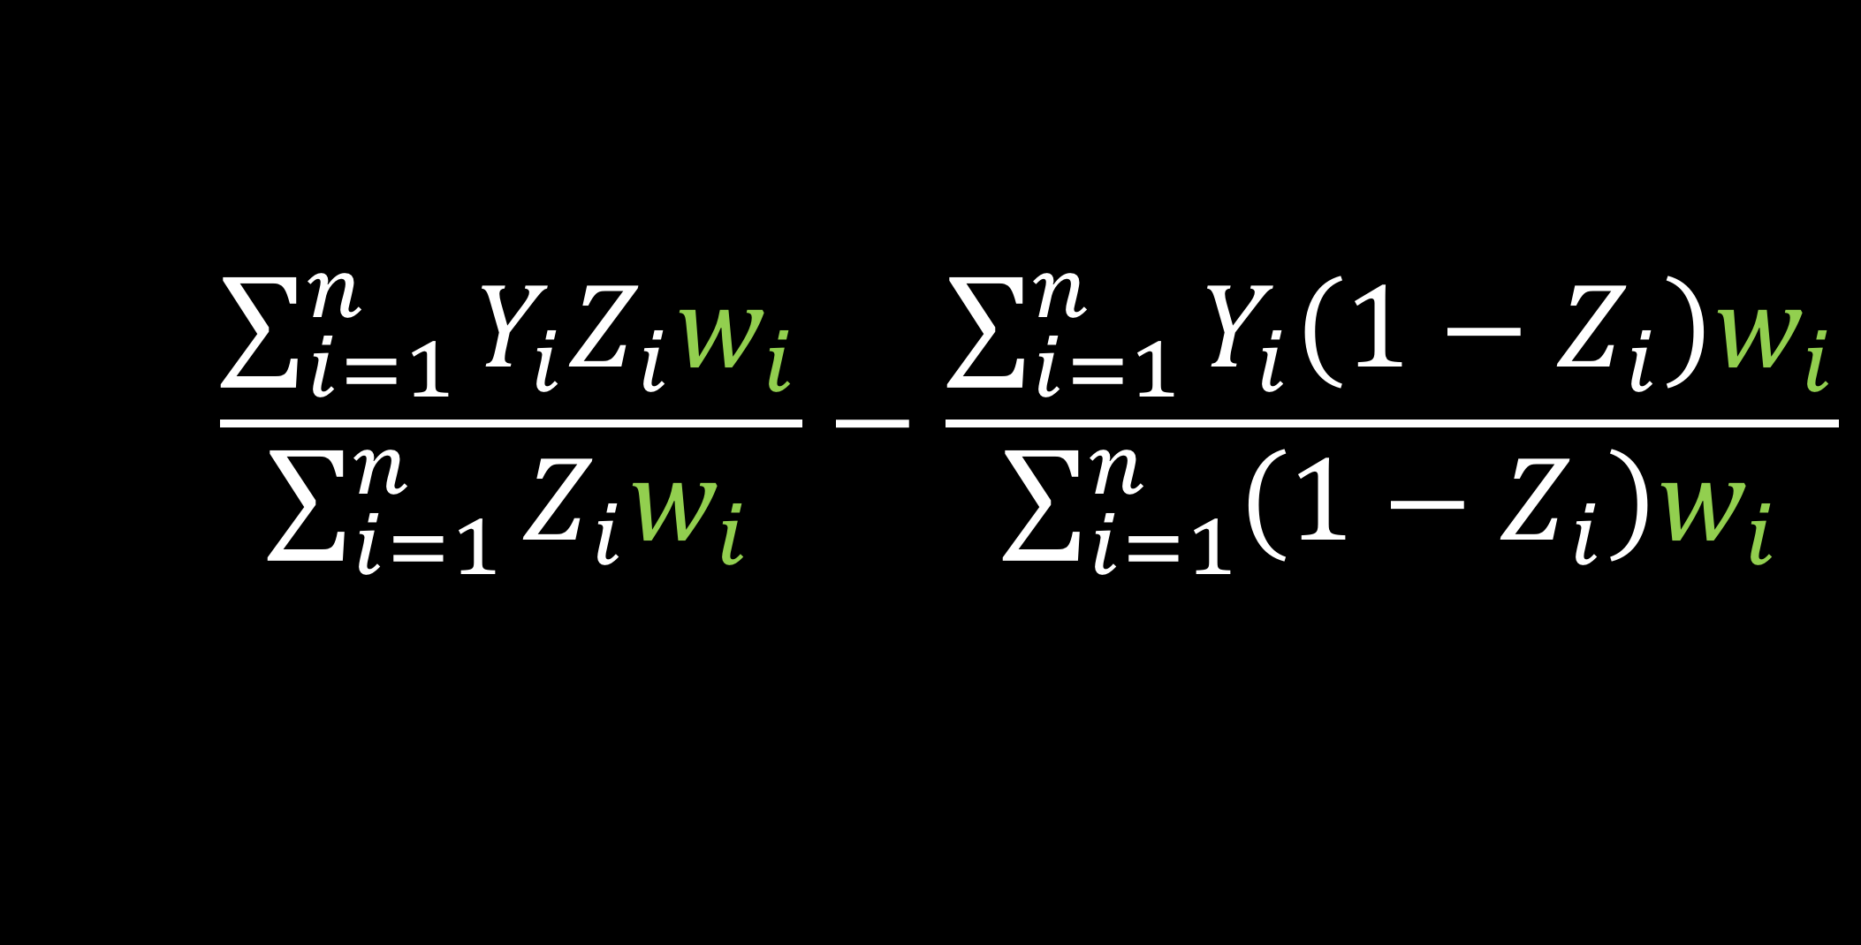
Estimate treatment effect
$$\frac{\sum_{i=1}^{n}{Y_{i}Z_{i}w_{i}}}{\sum_{i=1}^{n}{Z_{i}w_{i}}}−\frac{\sum_{i=1}^{n}{Y_{i}\left(1−Z_{i}\right)w_{i}}}{\sum_{i=1}^{n}{\left(1−Z_{i}\right)w_{i}}}$$
Notes:
This is a consistent estimator if the propensity score is correct.

Slide 32
✓
How do we compensate for non-random treatment assignment?
propensity scores
How do we incorporate the propensity scores?
weighting
✓
Notes:
Alright, so we are using propensity scores and we've decided on weighting
10 min

Slide 33
✓
How do we compensate for non-random treatment assignment?
propensity scores
How do we incorporate the propensity scores?
weighting
How do we calculate these weights?
✓
Notes:
Now how do we actually calculate these weights?

Slide 34
Method
Notes:
This is where my research comes in. In particular, I've examined the finite sample bias and variance properties of these three weighting schemes.

Slide 35
Weighting
ATE Average treatment effect
ATM Average treatment effect among the evenly matchable
ATO Average treatment effect among the overlap population
Notes:
There are many different potential weighting schemes based on the target population, or causal estimand, you are interested in. For this talk, we are going to talk about three, a classic weighting scheme for the Average treatment effect and two newer weighting schemes the Average treatment effect among the evenly matchable and the average treatment effect among the overlap population. I've put these along with their definitions on your handout, so you can refer to that if you forget, or feel free to stop me if an acronym is unclear.

Slide 36

Average treatment effect
$$w_{ATE}=\frac{Z_{i}}{e_{i}}+\frac{{1 −Z}_{i}}{1 −e_{i}}$$
Notes:
The first weight we are going to discuss allows you to estimate the average treatment effect. The target population here is the whole sample population, both treated and controlled. If we were to look at a table of pre-treatment characteristics of the patients before and after weighting, post weighting the characteristics would be balanced across treatment groups and would match that of the overall population. For example, if the average age overall in the cohort was 50, with the average age pre-weighting as 40 in the control group and 60 in the treatment group, post weighting the average age in the treatment group and control group would both match the overall unweighted average of 50.
While this is often declared as the population of interest, it is not always the medically or scientifically appropriate population. This is because estimating the ATE assumes that every participant can be switched from their current treatment to the opposite, which doesn’t always make sense. For example, it may not be medically appropriate for every participant who didn’t receive a treatment to receive it. I'm going to briefly step through this equation to give some intuition about what this weight is doing, and then show the pseudo population created when using this weight

Slide 37
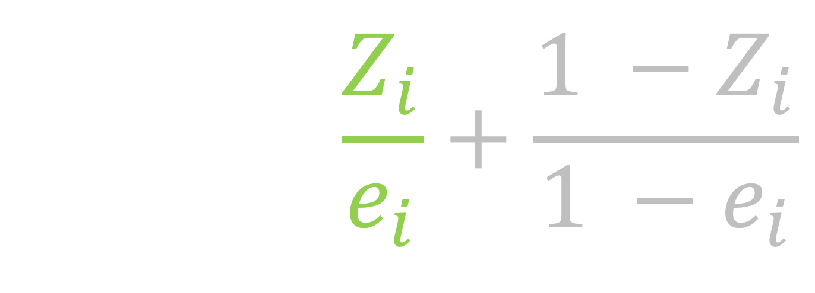
Average treatment effect
$$w_{ATE}=\frac{Z_{i}}{e_{i}}+\frac{{1 −Z}_{i}}{1 −e_{i}}$$
Notes:
participants who receive treatment will just have this part of the equation, since Zi is 1, making the second part 0. For these participants there weight is just 1 over their propensity score

Slide 38
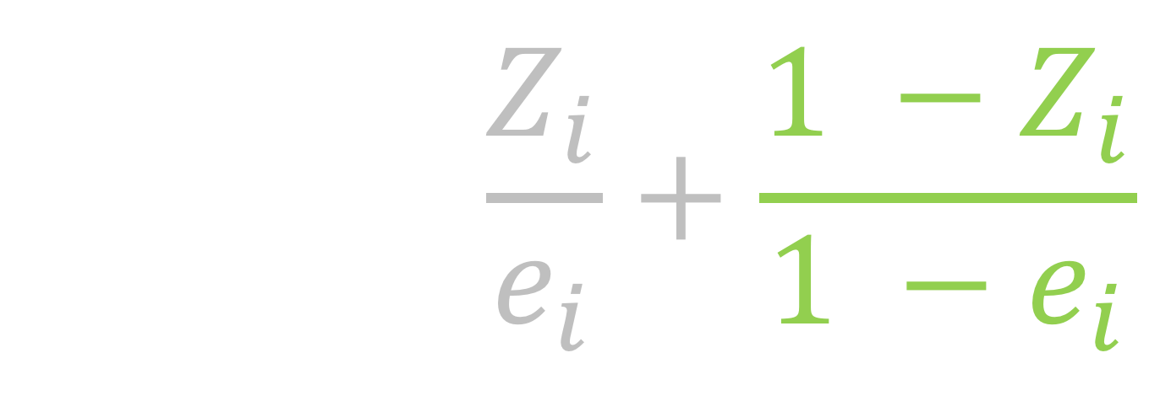
Average treatment effect
$$w_{ATE}=\frac{Z_{i}}{e_{i}}+\frac{{1 −Z}_{i}}{1 −e_{i}}$$
Notes:
the participants in the control group, will just have this part of the equation. Their weight will just be 1 over 1 minus the propensity score. So these ATE weights overall are just 1 over the probability of receiving the treatment that you received. An important thing to notice here is these weights range from 0 to infinity, so in theory they can be very very large

Slide 39
treatment
control
Notes:
Here, I have a mirrored histogram of the actual observed sample. On the top, above 0, I have the histogram of propensity scores among the treated. Notice here that the graph is skewed such that most of the mass is on the higher end. This makes sense since the propensity score is the probability of receiving treatment, we'd expect those who DID receive treatment to have often been more likely to do so. Now let's look at the other side, the mirrored histogram below 0. This is the histogram of propensity scores for the control group. Here, there is more mass towards 0, since these participants were more likely to NOT receive the treatment. Also notice that it looks like we have more participants in the treatment group than the control group. The ATE weights are trying to make these two populations look similar. We would expect that we will need to upweight some of these control patients on the higher side of the propensity scores, and upweight some of these treated participants on the low side of the propensity scores.

Slide 40
trt
control
Notes:
This is the same histogram as the previous slide, I've just shrunk it a bit to extend the y-axis so we can see the pseudo-population created from the ATE weights

Slide 41
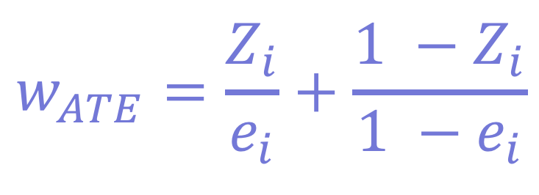
trt
$$w_{ATE}=\frac{Z_{i}}{e_{i}}+\frac{{1 −Z}_{i}}{1 −e_{i}}$$
control
151
Notes:
The dark portion, the grey, are the distribution of propensity scores and again the top part of the mirrored histogram is the treated population and the bottom, the upside-down histogram is the control population. Then the green represents the weighted population for the treated and the blue is the weighted population for the controls.
In other words, the green and blue represent the pseudo population created by using the weights (Frequency counts for a pseudo population based on the weights) [click] This guy at the far end has a propensity score greater than .99, and therefore ends up accounting for 151 people in the pseudo cohort.

Slide 42
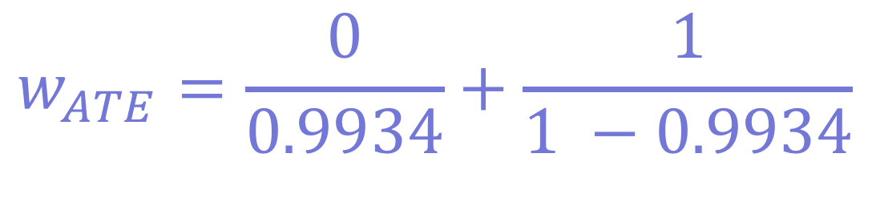
trt
$$w_{ATE}=\frac{0}{0.9934}+\frac{1}{1 −0.9934}$$
control
151
Notes:
If we plug in 0 for Zi, since this participant is in the control group, and 0.9934, their propensity score, for ei

Slide 43
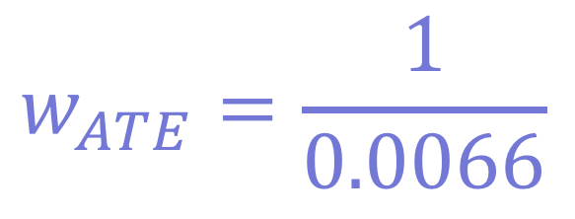
trt
$$w_{ATE}=\frac{1}{0.0066}$$
control
151
Notes:
We end up with 1 over 0.0066 or 151. Intuitively, it can probably cause some problems if we are allowing single participants to represent a large number of participants in a pseudo cohort.

Slide 44

Average treatment effect among the evenly matchable
$$w_{ATM}=\frac{min\left\{e_{i}, 1−e_{i}\right\}}{{e_{i}Z}_{i}+(1 −e_{i})(1−Z_{i})}$$
Li & Greene (2013)
Notes:
A newer weighting scheme introduced by Li and Greene in 2013 are matching weights. These estimate the average treatment effect among the evenly matchable. The pseudo-cohort they create is akin to the cohort that would be created via 1:1 pair matching. Here the weight is the minimum of the propensity score and 1 minus the propensity score over the propensity score for the treated and 1 minus the propensity score for the controls. Notably, this weight is more stable than the ATE weights in that it is bounded by 0 and 1.

Slide 45
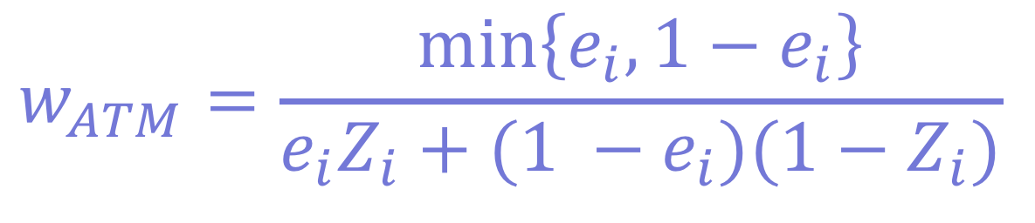
$$w_{ATM}=\frac{min\left\{e_{i}, 1−e_{i}\right\}}{{e_{i}Z}_{i}+(1 −e_{i})(1−Z_{i})}$$
treatment
control
1
Notes:
[click] notice now that rather than representing 151, this participant now just has a weight of 1, and the 20 treated participants above it each have a weight of 1/20

Slide 46
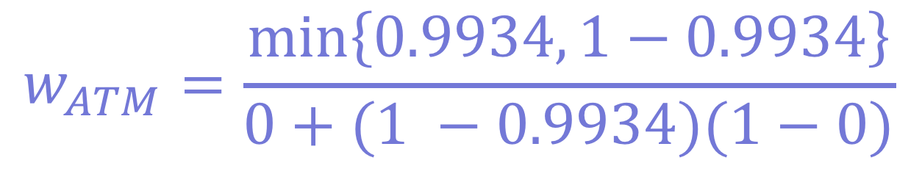
$$w_{ATM}=\frac{min\left\{0.9934, 1−0.9934\right\}}{0+(1 −0.9934)(1−0)}$$
treatment
control
1
Notes:
plugging in that propensity score and 0 for Zi

Slide 47
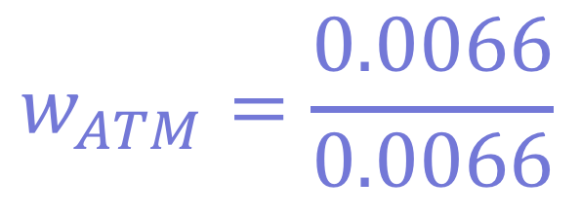
$$w_{ATM}=\frac{0.0066}{0.0066}$$
treatment
control
1
Notes:
we end up with 0.0066 over 0.0066, or 1.

Slide 48

Average treatment effect among the overlap population
$$w_{ATO}=\left(1−e_{i}\right)Z_{i}+ e_{i}(1−Z_{i})$$
Li et al (2016)
Notes:
Finally, the overlap weights derived by Li et al in 2016 estimate the average treatment effect among the overlap population. Here, we are constructing a pseudo-population that will have the most overlap in the covariates between treatment groups. In practice, this creates a cohort often very similar to the matching weights, with some improved variance properties. Here the weight is 1 minus the propensity score for the treated and the propensity score for the controls. So again, this is going to be bounded by 0 and 1

Slide 49
treatment
control
Notes:
Here is what that pseudo population looks like. The population will look a lot like a Table 1 from a 1:1 matched trial, but shifted a bit to improve the variance.

Slide 50
ATE
ATM
AT0
Notes:
Here are the three pseudo-populations side by side so you can get a better idea for the difference

Slide 51
ATE
ATM
AT0
Notes:
With the weights for estimating the average treatment effect ranging from 0 to infinity

Slide 52
ATE
ATM
AT0
Notes:
And these newer, more stable weights, ranging from 0 to 1.

Slide 53
✓
How do we compensate for non-random treatment assignment?
propensity scores
How do we incorporate the propensity scores?
weighting
How do we calculate these weights?
✓
✓
Notes:
Alright so now we have a bit of a better understanding for how to calculate these weights,

Slide 54
✓
How do we compensate for non-random treatment assignment?
propensity scores
How do we incorporate the propensity scores?
weighting
How do we calculate these weights?
Which weights should we choose?
✓
✓
Notes:
How do we pick which ones to use?

Slide 55
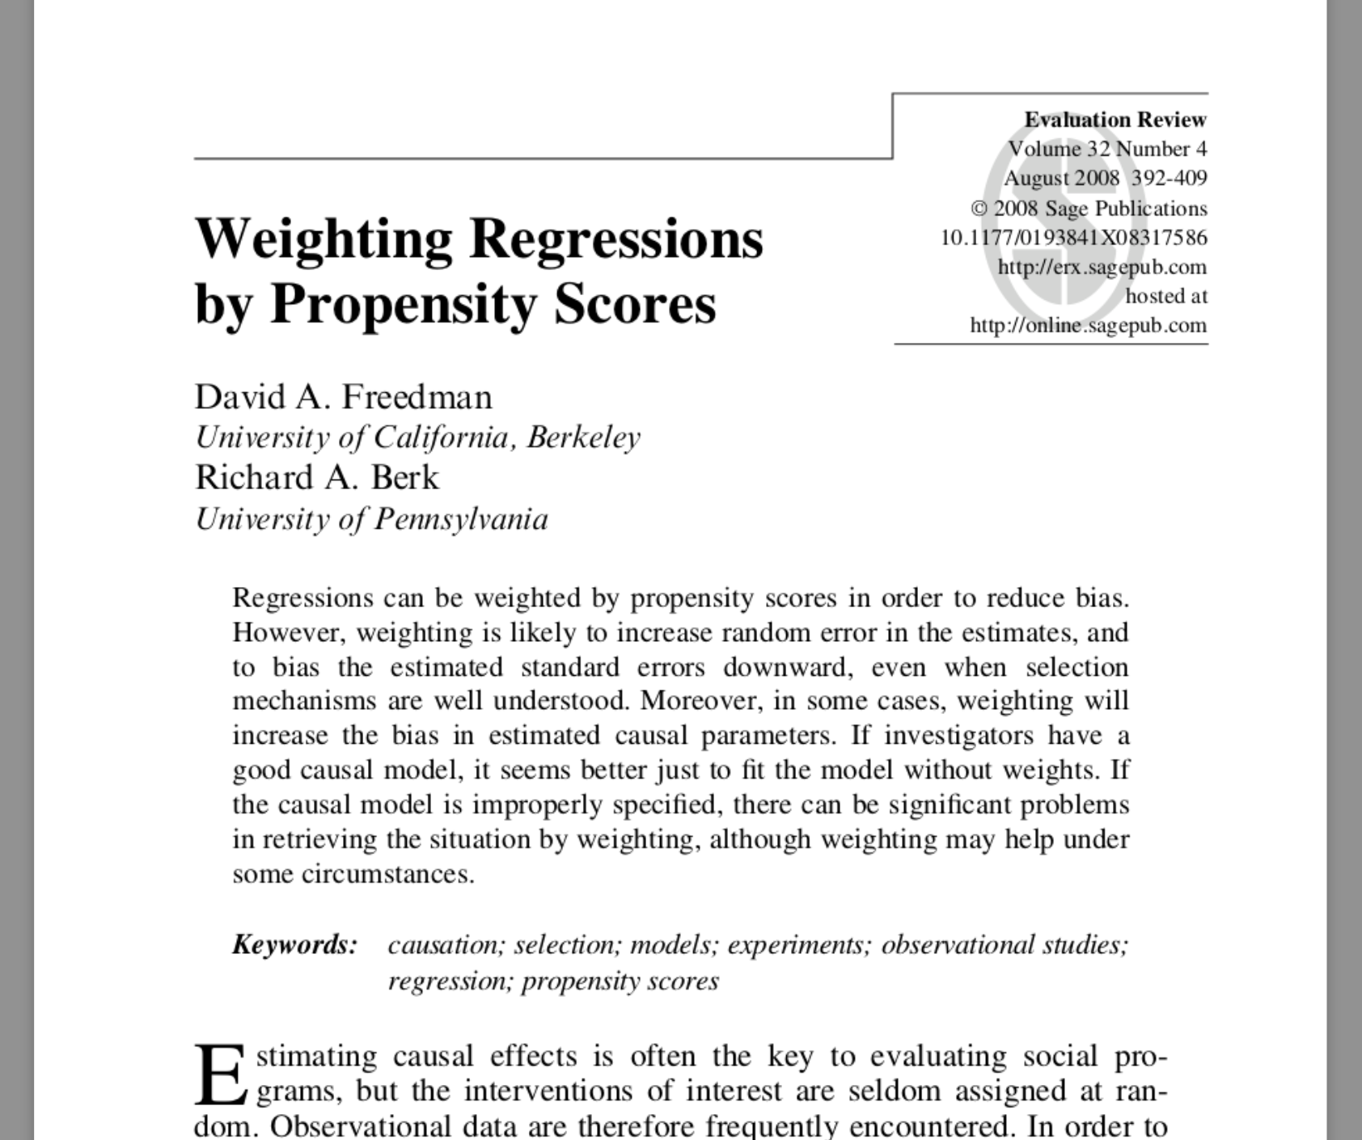

Slide 56
Propensity score weighting method
The weights used in Freedman & Berk (2008) are estimating ATE
ATE weights can explode
151
Notes:
These are known to be unstable because the weights can range from 0 to infinity

Slide 57
Propensity score weighting method
The weights used in Freedman & Berk (2008) are estimating ATE
ATE weights can explode
Hypothesize that ATO and ATM weights will perform better
Notes:
These are known to be unstable because the weights can range from 0 to infinity

Slide 58
Fit a misspecified model
Allow the propensity score to be correct
The outcome model is missing a covariate
Notes:
They are intentionally creating a setup that is seemingly friendly to weighting to show that it fails even when it should have been working great

Slide 59
Freedman & Berk Simulation
Notes:
Freedman and Berk demonstrated that propensity score weighting introduced bias and large standard errors. In their simulation, they fixed their sample size at 1000. To get a handle on this bias, we examined sample sizes from 100 to 10,000. We know that the propensity score was modeled correctly, so we would expect the estimate to be consistent, and therefore the bias to reduce as the sample size increases, but the rate at which it is decreasing is definitely of interest. We also introduced the two new weighting schemes to see how they fared under these simulated conditions.

Slide 60
x₁
x₂
z
y
Notes:
In this simulation, we have two pre-treatment covariates, x1 and x2. Both are confounders, in other words associated with the exposure, z as well as the outcome y. z, the exposure or treatment variable, is associated with y the outcome variable

Slide 61
1
x₁
x₂
0.25
2
0.75
1
z
1
y

Slide 62
1
x₁
x₂
0.25
2
0.75
1
z
1
y

Slide 63
1
x₁
x₂
0.25
2
0.75
1
z
1
y

Slide 64
1
x₁
x₂
0.25
2
0.75
1
z
1
y

Slide 65
1
x₁
x₂
0.25
2
0.75
1
z
1
y

Slide 66
Propensity score model
x₁
x₂
z
Notes:
So we fit a propensity score model that is correctly specified, that is has the correct pre-treatment covariates. Because it is correctly specified, we know our treatment effect will be consistent, but it may be biased in finite samples.

Slide 67
Outcome model
x₁
x₂
z
y
Notes:
The outcome model is missing one covariate, x2.

Slide 68
treatment
ctrl
Notes:
Here is a mirrored histogram of this population. Just looking at this, we can see that the ATE weights are going to have some trouble since there are so many more treated than control patients, especially towards the higher end.
TODO weighted hist

Slide 69
n = 1000
Notes:
Let me take a few minutes to explain this graph.
At n = 1000, Freedman and Berk report a bias of 0.13 and we replicate this. Even when n is 10,000, the result is still biased. So they of course were correct, these weights do lead to bias in finite samples.

Slide 70
Notes:
However it turns out to be less of a story about weighting in general, and more of a story about these particular weights.

Slide 71
Notes:
delete

Slide 72
Standard errors

Slide 73
Outcome model
x₁
x₂
z
y

Slide 74
Notes:
We replicate what Freedman and Berk show, that this difference in the true standard error of these estimates is 0.12.

Slide 75
Notes:
Correct-correct
Minimum variance unbiased estimator

Slide 77
✓
How do we compensate for non-random treatment assignment?
propensity scores
How do we incorporate the propensity scores?
weighting
How do we calculate these weights?
Which weights should we choose?
ATM and ATO weights had improved finite-sample properties
✓
✓
✓

Slide 78
✓
How do we compensate for non-random treatment assignment?
propensity scores
How do we incorporate the propensity scores?
weighting
How do we calculate these weights?
Which weights should we choose?
The variance for the ATO and ATM is preferable to that of the ATE
✓
✓
✓

Slide 79
✓
How do we compensate for non-random treatment assignment?
propensity scores
How do we incorporate the propensity scores?
weighting
How do we calculate these weights?
Which weights should we choose?
The variance for the ATO and ATM is preferable to that of the ATE
✓
✓
✓

Slide 80
✓
How do we compensate for non-random treatment assignment?
propensity scores
How do we incorporate the propensity scores?
weighting
How do we calculate these weights?
Which weights should we choose?
The variance for the ATO and ATM is preferable to that of the ATE
How do we estimate the treatment effect?
✓
✓
✓

Slide 81
Estimation
Notes:
28 min

Slide 82
We want to use a propensity score model and also adjust the outcome model

Slide 83
Doubly robust estimators
Fit a propensity score model
Fit two outcome models
Use these to estimate an average treatment effect
As long as one is correctly specified, your result will be consistent
Notes:
We’re going to focus on the example where what they do is the doubly robust estimator

Slide 84
Doubly robust estimators
Lunceford and Davidian (2004) derived a consistent estimator for the ATE
Li and Greene (2013) derived a consistent estimator for the ATM
We derive a consistent estimator for the ATO

Slide 85
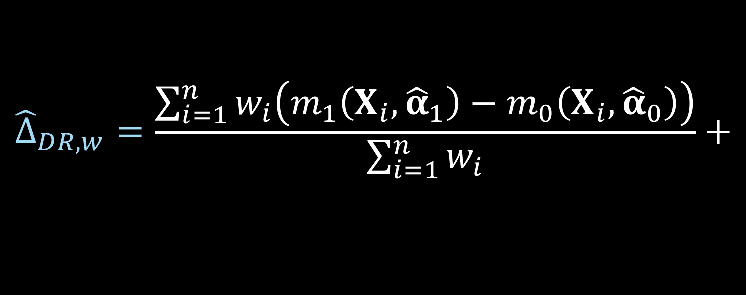


Doubly robust estimator
$${\hat{Δ}}_{DR, w}=\frac{\sum_{i=1}^{n}{w_{i}\left(m_{1}\left(X_{i},{\hat{α}}_{1}\right)−m_{0}\left(X_{i}, {\hat{α}}_{0}\right)\right)}}{\sum_{i=1}^{n}{w_{i}}}+$$
$$\frac{\sum_{i=1}^{n}{w_{i}Z_{i}\left(Y_{i}−m_{1}\left(X_{i}, {\hat{α}}_{1}\right)\right)}}{\sum_{i=1}^{n}{w_{i}}Z_{i}}−$$
$$\frac{\sum_{i=1}^{n}{w_{i}{(1−Z}_{i})\left(Y_{i}−m_{0}\left(X_{i}, {\hat{α}}_{0}\right)\right)}}{\sum_{i=1}^{n}{w_{i}}(1−Z_{i})}$$
Notes:
Consistent if either the propensity score model is correct or outcome

Slide 86
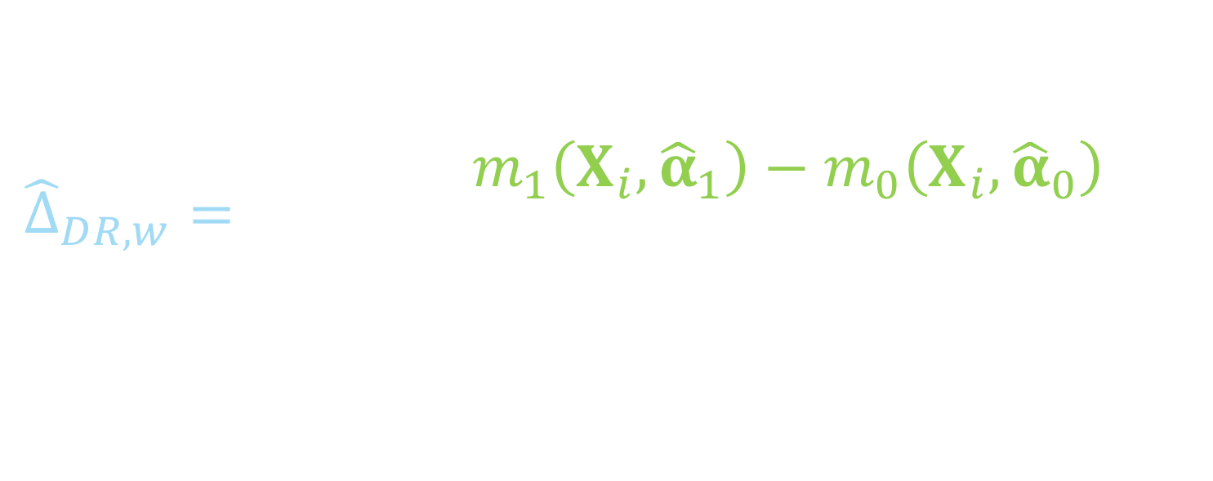
Doubly robust estimator
$${\hat{Δ}}_{DR, w}=\frac{\sum_{i=1}^{n}{w_{i}\left(m_{1}\left(X_{i},{\hat{α}}_{1}\right)−m_{0}\left(X_{i}, {\hat{α}}_{0}\right)\right)}}{\sum_{i=1}^{n}{w_{i}}}+$$
$$\frac{\sum_{i=1}^{n}{w_{i}Z_{i}\left(Y_{i}−m_{1}\left(X_{i}, {\hat{α}}_{1}\right)\right)}}{\sum_{i=1}^{n}{w_{i}}Z_{i}}−$$
$$\frac{\sum_{i=1}^{n}{w_{i}{(1−Z}_{i})\left(Y_{i}−m_{0}\left(X_{i}, {\hat{α}}_{0}\right)\right)}}{\sum_{i=1}^{n}{w_{i}}(1−Z_{i})}$$
Notes:
Consistent if either the propensity score model is correct or outcome

Slide 87

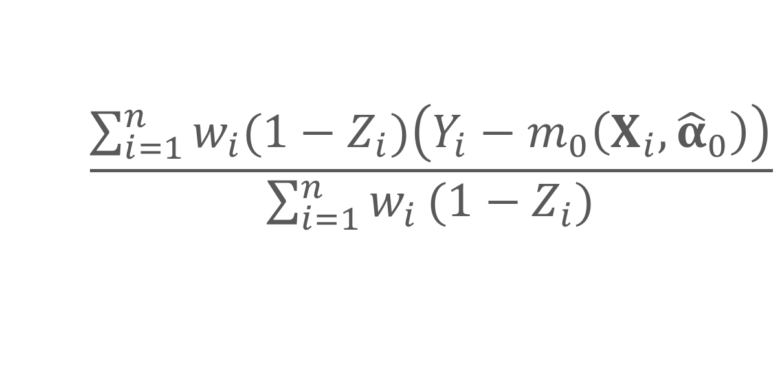
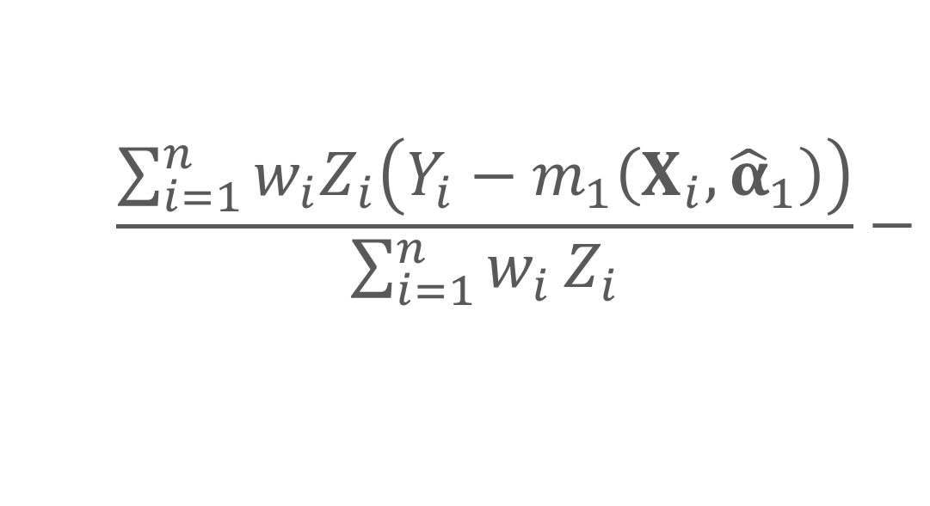
Doubly robust estimator
$${\hat{Δ}}_{DR, w}=\frac{\sum_{i=1}^{n}{w_{i}\left(m_{1}\left(X_{i},{\hat{α}}_{1}\right)−m_{0}\left(X_{i}, {\hat{α}}_{0}\right)\right)}}{\sum_{i=1}^{n}{w_{i}}}+$$
$${\hat{y}}_{treated}−{\hat{y}}_{controls}$$
$$\frac{\sum_{i=1}^{n}{w_{i}Z_{i}\left(Y_{i}−m_{1}\left(X_{i}, {\hat{α}}_{1}\right)\right)}}{\sum_{i=1}^{n}{w_{i}}Z_{i}}−$$
$$\frac{\sum_{i=1}^{n}{w_{i}{(1−Z}_{i})\left(Y_{i}−m_{0}\left(X_{i}, {\hat{α}}_{0}\right)\right)}}{\sum_{i=1}^{n}{w_{i}}(1−Z_{i})}$$
Notes:
Consistent if either the propensity score model is correct or outcome

Slide 88
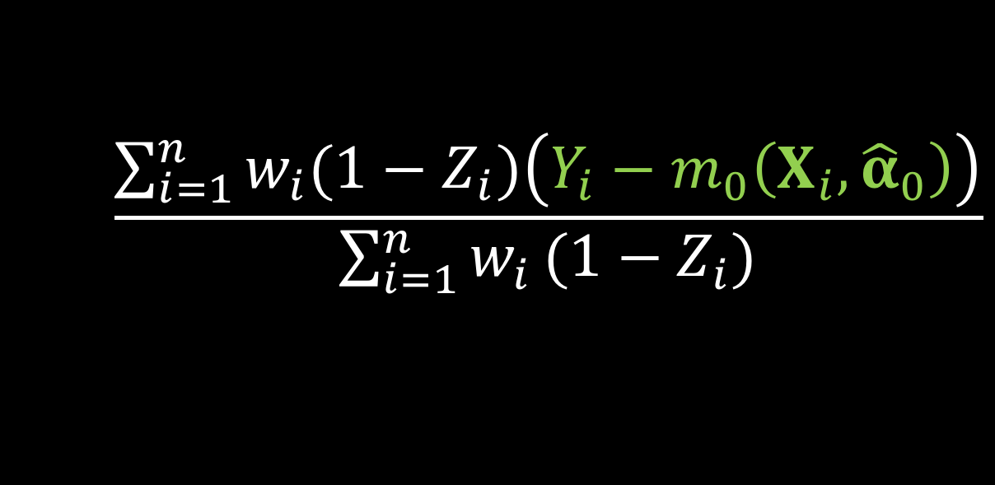
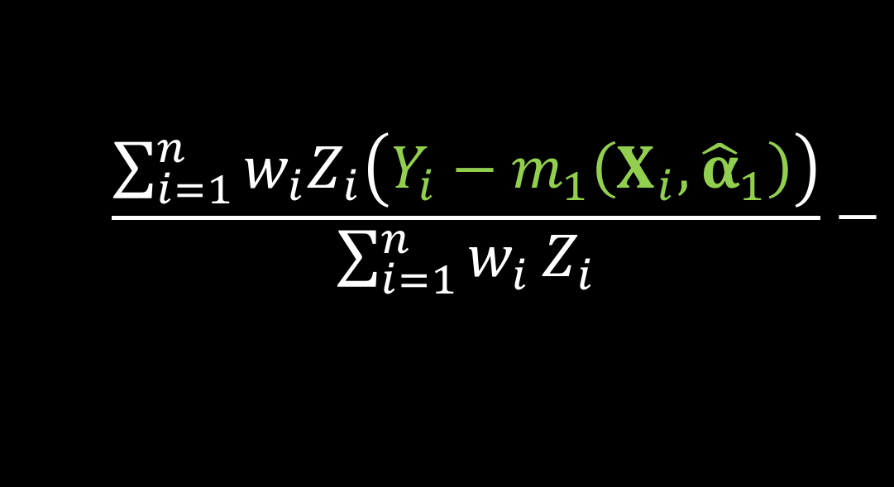
Doubly robust estimator
$${\hat{Δ}}_{DR, w}=\frac{\sum_{i=1}^{n}{w_{i}\left(m_{1}\left(X_{i},{\hat{α}}_{1}\right)−m_{0}\left(X_{i}, {\hat{α}}_{0}\right)\right)}}{\sum_{i=1}^{n}{w_{i}}}+$$
$$\frac{\sum_{i=1}^{n}{w_{i}Z_{i}\left(Y_{i}−m_{1}\left(X_{i}, {\hat{α}}_{1}\right)\right)}}{\sum_{i=1}^{n}{w_{i}}Z_{i}}−$$
$$\frac{\sum_{i=1}^{n}{w_{i}{(1−Z}_{i})\left(Y_{i}−m_{0}\left(X_{i}, {\hat{α}}_{0}\right)\right)}}{\sum_{i=1}^{n}{w_{i}}(1−Z_{i})}$$
Notes:
residuals

Slide 89
Doubly robust estimator
$${\hat{Δ}}_{DR, w}=\frac{\sum_{i=1}^{n}{w_{i}\left(m_{1}\left(X_{i},{\hat{α}}_{1}\right)−m_{0}\left(X_{i}, {\hat{α}}_{0}\right)\right)}}{\sum_{i=1}^{n}{w_{i}}}+$$
$$\frac{\sum_{i=1}^{n}{w_{i}Z_{i}\left(Y_{i}−m_{1}\left(X_{i}, {\hat{α}}_{1}\right)\right)}}{\sum_{i=1}^{n}{w_{i}}Z_{i}}−$$
$$\frac{\sum_{i=1}^{n}{w_{i}{(1−Z}_{i})\left(Y_{i}−m_{0}\left(X_{i}, {\hat{α}}_{0}\right)\right)}}{\sum_{i=1}^{n}{w_{i}}(1−Z_{i})}$$
Notes:
Consistent if either the propensity score model is correct or outcome

Slide 90

ATO DR estimator
$${\hat{Δ}}_{DR, ATO}={\hat{δ}}_{1}+{\hat{δ}}_{2}−{\hat{δ}}_{3}$$
Notes:
We can write the doubly robust estimator for the ATO in 3 equations, delta 1, delta2 and delta 3

Slide 91


ATO DR estimator
$$0=\sum_{i=1}^{n}{u_{i}\left(θ\right)}$$
$$θ={\left(δ_{1}, δ_{2},δ_{3},α_{1}^{T},α_{0}^{T},β^{T}\right)}^{T}$$
Notes:
we can estimate the propensity score and the treatment effect simultaneously in one step by solving the following estimating equations with respect to theta (we don’t have to solve them jointly for the point estimate, but having this form will make the variance estimation more straightforward)

Slide 92

ATO DR estimator
$$u\left(θ\right)=\left(\begin{matrix}δ_{1} \\ δ_{2} \\ \begin{aligned}δ_{3} \\ \left(Y−m_{1}\left(X,α_{1}\right)\right)ZX \\ \left(Y−m_{0}\left(X,α_{0}\right)\right)\left(1−Z\right)X \\ X\left(Z−e\left(X,β\right)\right)\end{aligned}\end{matrix}\right)$$
$$θ={\left(δ_{1}, δ_{2},δ_{3},α_{1}^{T},α_{0}^{T},β^{T}\right)}^{T}$$
Notes:
This can be solved by simultaneously solving these estimating equations.

Slide 93
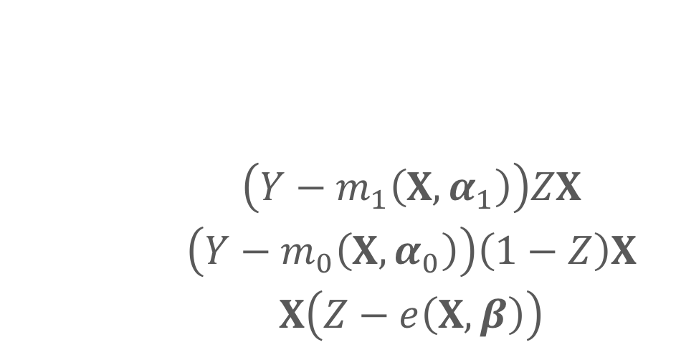
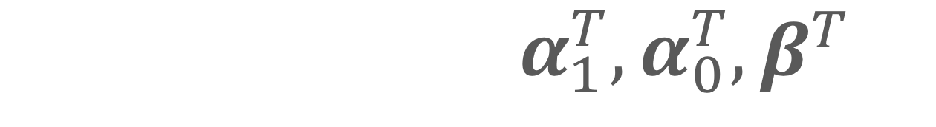
ATO DR estimator
$$u\left(θ\right)=\left(\begin{matrix}δ_{1} \\ δ_{2} \\ \begin{aligned}δ_{3} \\ \left(Y−m_{1}\left(X,α_{1}\right)\right)ZX \\ \left(Y−m_{0}\left(X,α_{0}\right)\right)\left(1−Z\right)X \\ X\left(Z−e\left(X,β\right)\right)\end{aligned}\end{matrix}\right)$$
$$θ={\left(δ_{1}, δ_{2},δ_{3},α_{1}^{T},α_{0}^{T},β^{T}\right)}^{T}$$

Slide 94
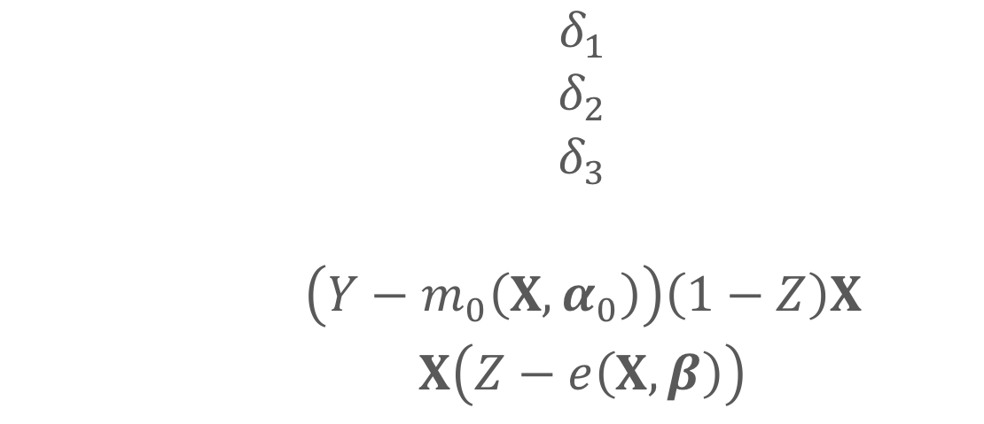
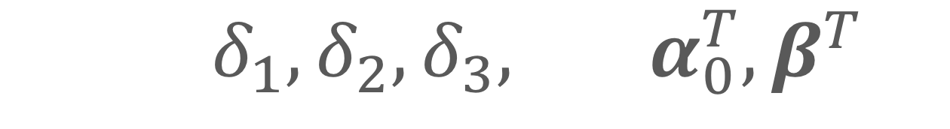
ATO DR estimator
$$u\left(θ\right)=\left(\begin{matrix}δ_{1} \\ δ_{2} \\ \begin{aligned}δ_{3} \\ outcome model (treatment) \\ \left(Y−m_{0}\left(X,α_{0}\right)\right)\left(1−Z\right)X \\ X\left(Z−e\left(X,β\right)\right)\end{aligned}\end{matrix}\right)$$
$$θ={\left(δ_{1}, δ_{2},δ_{3},α_{1}^{T},α_{0}^{T},β^{T}\right)}^{T}$$

Slide 95
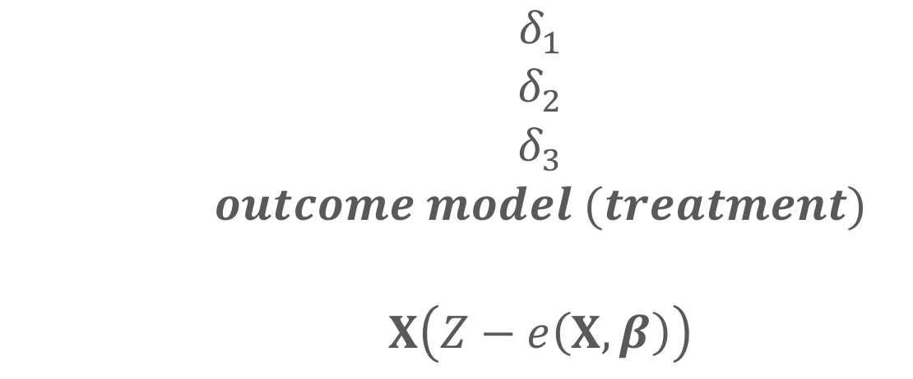
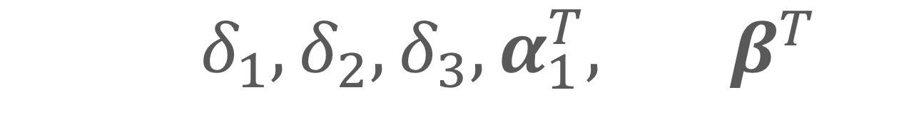
ATO DR estimator
$$u\left(θ\right)=\left(\begin{matrix}δ_{1} \\ δ_{2} \\ \begin{aligned}δ_{3} \\ outcome model (treatment) \\ outcome model (control) \\ X\left(Z−e\left(X,β\right)\right)\end{aligned}\end{matrix}\right)$$
$$θ={\left(δ_{1}, δ_{2},δ_{3},α_{1}^{T},α_{0}^{T},β^{T}\right)}^{T}$$

Slide 96
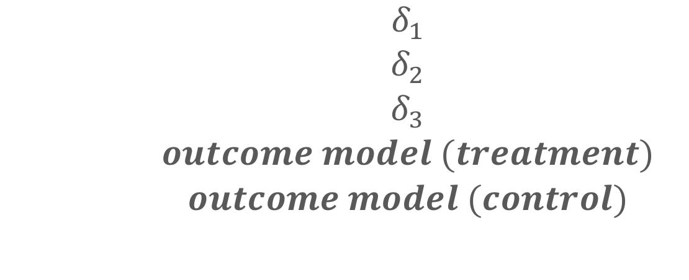

ATO DR estimator
$$u\left(θ\right)=\left(\begin{matrix}δ_{1} \\ δ_{2} \\ \begin{aligned}δ_{3} \\ outcome model (treatment) \\ outcome model (control) \\ propensity score model\end{aligned}\end{matrix}\right)$$
$$θ={\left(δ_{1}, δ_{2},δ_{3},α_{1}^{T},α_{0}^{T},β^{T}\right)}^{T}$$

Slide 97
✓
How do we compensate for non-random treatment assignment?
propensity scores
How do we incorporate the propensity scores?
weighting
How do we calculate these weights?
Which weights should we choose?
The variance for the ATO and ATM is preferable to that of the ATE
How do we estimate the treatment effect?
Doubly robust estimator
✓
✓
✓
✓

Slide 98
✓
How do we compensate for non-random treatment assignment?
propensity scores
How do we incorporate the propensity scores?
weighting
How do we calculate these weights?
Which weights should we choose?
The variance for the ATO and ATM is preferable to that of the ATE
How do we estimate the treatment effect?
Doubly robust estimator
How do we estimate the variability?
✓
✓
✓
✓

Slide 99
ATO DR estimator
$$0=\sum_{i=1}^{n}{u_{i}\left(θ\right)}$$
$$θ={\left(δ_{1}, δ_{2},δ_{3},α_{1}^{T},α_{0}^{T},β^{T}\right)}^{T}$$

Slide 100

M-Estimation
$$\sqrt{n}\left(\hat{θ}−θ\right)\underset{→}{d}N(0, A^{−1}BA^{−T})$$
Notes:
Since these estimating equations are unbiased, U of theta is an example of an M-estimator. The asymptotic distribution of an M estimator is the following.
the negative T is just inverse transpose

Slide 101

Sandwich estimator
$$A^{−1}BA^{−T}$$
Notes:
Note here that this technically will only be correct if both the outcome model AND the propensity score model are correctly specified.

Slide 102

Sandwich estimator
$$A^{−1}BA^{−T}$$
$$A=−E\left[\frac{∂u\left(θ\right)}{∂θ}\right]$$
Notes:
A is the model-based estimate, B is the “robust” estimate of the information (the variance of the score function)

Slide 103

Sandwich estimator
$$A^{−1}BA^{−T}$$
$B=E\left[u\left(θ\right)u{\left(θ\right)}^{T}\right]$
Notes:
, B is the “robust” estimate of the information (the variance of the score function)

Slide 104

Sandwich estimator
$$\hat{var}\left(\hat{θ}\right)=\frac{1}{n}{{\hat{A}}_{n}}^{−1}{\hat{B}}_{n}{{\hat{A}}_{n}}^{−T}$$
Notes:
We can replace the expectations by the sample average to get an approximate large sample variance

Slide 105
✓
How do we compensate for non-random treatment assignment?
propensity scores
How do we incorporate the propensity scores?
weighting
How do we calculate these weights?
Which weights should we choose?
The variance for the ATO and ATM is preferable to that of the ATE
How do we estimate the treatment effect?
Doubly robust estimator
How do we estimate the variability?
Sandwich estimator
✓
✓
✓
✓
✓

Slide 106
✓
How do we compensate for non-random treatment assignment?
propensity scores
How do we incorporate the propensity scores?
weighting
How do we calculate these weights?
Which weights should we choose?
The variance for the ATO and ATM is preferable to that of the ATE
How do we estimate the treatment effect?
Doubly robust estimator
How do we estimate the variability?
Sandwich estimator
✓
✓
✓
✓
✓

Slide 107
✓
How do we compensate for non-random treatment assignment?
propensity scores
How do we incorporate the propensity scores?
weighting
How do we calculate these weights?
Which weights should we choose?
The variance for the ATO and ATM is preferable to that of the ATE
How do we estimate the treatment effect?
Doubly robust estimator
How do we estimate the variability?
Sandwich estimator
What if our assumptions are violated?
✓
✓
✓
✓
✓

Slide 108
Sensitivity Analysis
Notes:
35

Slide 109
Motivation
Review of 90 observational studies JAMA, NEJM, and AJE
41 mentioned the issue of unmeasured confounding as a limitation
4 performed a quantitative sensitivity analysis
Notes:
We conducted a review of 90 observational studies with statistically significant findings published in 2015 in the Journal of the American Medical Association, the New England Journal of Medicine, and the American Journal of Epidemiology. 41 (45.6%) mentioning the issue of unmeasured confounding as a limitation and only 4 (4.4%) performing a quantitative sensitivity analysis.

Slide 110
✌️ Contributions
Examine the measured confounders via an observed bias plot
Use this to inform how we think about unmeasured confounders via observed covariate E-values

Slide 111
0.2
0.9
Treatment effect:
1.21 (1.09, 1.34)
0.3
0.7
0.1
0.1
0.3
0.6
0.6
0.9
0.2
0.2
0.3
0.1
0.1
0.8
0.7
0.7
0.8
0.2
0.2
Notes:
Let’s bring back our goofy example. We do our propensity score weighting [click] to make the two groups comparable and then estimate the treatment effect using the methods we’ve discussed. [click] we end up with an observed treatment effect of 1.21 with a confidence interval of 1.09 to 1.34. Awesome, but what if we’re missing something?

Slide 112
Meaningful confounders
1. How imbalanced is the unmeasured confounder between the exposure groups?
2. How predictive is the unmeasured confounder of the outcome?
3. How independent is the unmeasured confounder from the other covariates?

Slide 113
Observed bias plot
Notes:
Let me take a minute to explain this plot.

Slide 114
Observed bias plot
Notes:
*observed bias factor

Slide 115
Observed bias plot

Slide 116

Tipping point analyses
what will tip our confidence bound to cross 1
Notes:
We’ve formally defined these tipping point analyses for binary and continuous unmeasured confounders

Slide 117
Observed bias plot

Slide 118
What does that unmeasured confounder look like?
Observed bias plot
Notes:
Is it plausible?

Slide 119
You need
Exposure-outcome effect
Exposure-unmeasured confounder effect
Outcome-unmeasured confounder effect
Health Policy Takeout Thursday

Slide 120
You need
Exposure-outcome effect generally estimated from a model, for example an odds ratio, hazard ratio, or risk ratio
Exposure-unmeasured confounder effect
Outcome-unmeasured confounder effect

Slide 121
You need
Exposure-outcome effect generally estimated from a model, for example an odds ratio, hazard ratio, or risk ratio
Exposure-unmeasured confounder effect
Outcome-unmeasured confounder effect

Slide 122
You need
Exposure-outcome effect generally estimated from a model, for example an odds ratio, hazard ratio, or risk ratio
Exposure-unmeasured confounder effect
Outcome-unmeasured confounder effect
Notes:
Instead of specifying these, we can use a new concept known as the E-value

Slide 123
E-value
$$E−value=LB_{obs}+\sqrt{LB_{obs}×(LB_{obs}−1)}$$
Ding and VanderWeele (2017)
Notes:
explain LB
Vanderweele and Ding’s, it is the point that minimizes the strength of association, on the risk ratio scale, that an unmeasured confounder would need to have with both the exposure and outcome, conditional on the measured covariates, to explain away an observed exposure-outcome association. Again this is certainly one way to look at the analysis, but can be difficult contextualize without more information.

Slide 124

Observed covariate E-value
$$E−{value}_{adj}=\frac{LB_{obs}}{LB_{adj}}+\sqrt{\frac{LB_{obs}}{LB_{adj}}×\left(\frac{LB_{obs}}{LB_{adj}}−1\right)}$$
Notes:
we’ve used similar methodology to create an observed covariate e-value, where we allow you to input the value you are trying to adjust to, rather than always setting the adjusted limiting bound to one. Replacing LB adj with the lower bound of the observed bias factors, we can calculate a quantity that would demonstrate what the E-value would be if the only unmeasured confounder were the one we dropped to calculate the observed bias factor

Slide 126
R package
tipr
Notes:
And we’ve created an R-package to calculate them

Slide 127
✓
How do we compensate for non-random treatment assignment?
propensity scores
How do we incorporate the propensity scores?
weighting
How do we calculate these weights?
Which weights should we choose?
The variance for the ATO and ATM is preferable to that of the ATE
How do we estimate the treatment effect?
Doubly robust estimator
How do we estimate the variability?
Sandwich estimator
What if our assumptions are violated?
Perform a quantitative sensitivity analysis
✓
✓
✓
✓
✓
✓

Slide 128
✓
How do we compensate for non-random treatment assignment?
propensity scores
How do we incorporate the propensity scores?
weighting
How do we calculate these weights?
Which weights should we choose?
The variance for the ATO and ATM is preferable to that of the ATE
How do we estimate the treatment effect?
Doubly robust estimator
How do we estimate the variability?
Sandwich estimator
What if our assumptions are violated?
Perform a quantitative sensitivity analysis
✓
✓
✓
✓
✓
✓

Slide 129
✓
How do we compensate for non-random treatment assignment?
propensity scores
How do we incorporate the propensity scores?
weighting
How do we calculate these weights?
Which weights should we choose?
The variance for the ATO and ATM is preferable to that of the ATE
How do we estimate the treatment effect?
Doubly robust estimator
How do we estimate the variability?
Sandwich estimator
What if our assumptions are violated?
Perform a quantitative sensitivity analysis
✓
✓
✓
✓
✓
✓

Slide 130
✓
How do we compensate for non-random treatment assignment?
propensity scores
How do we incorporate the propensity scores?
weighting
How do we calculate these weights?
Which weights should we choose?
The variance for the ATO and ATM is preferable to that of the ATE
How do we estimate the treatment effect?
Doubly robust estimator
How do we estimate the variability?
Sandwich estimator
What if our assumptions are violated?
Perform a quantitative sensitivity analysis
✓
✓
✓
✓
✓
✓

Slide 131
✓
How do we compensate for non-random treatment assignment?
propensity scores
How do we incorporate the propensity scores?
weighting
How do we calculate these weights?
Which weights should we choose?
The variance for the ATO and ATM is preferable to that of the ATE
How do we estimate the treatment effect?
Doubly robust estimator
How do we estimate the variability?
Sandwich estimator
What if our assumptions are violated?
Perform a quantitative sensitivity analysis
✓
✓
✓
✓
✓
✓

Slide 132
✓
How do we compensate for non-random treatment assignment?
propensity scores
How do we incorporate the propensity scores?
weighting
How do we calculate these weights?
Which weights should we choose?
The variance for the ATO and ATM is preferable to that of the ATE
How do we estimate the treatment effect?
Doubly robust estimator
How do we estimate the variability?
Sandwich estimator
What if our assumptions are violated?
Perform a quantitative sensitivity analysis
✓
✓
✓
✓
✓
✓

Slide 133
✓
How do we compensate for non-random treatment assignment?
propensity scores
How do we incorporate the propensity scores?
weighting
How do we calculate these weights?
Which weights should we choose?
The variance for the ATO and ATM is preferable to that of the ATE
How do we estimate the treatment effect?
Doubly robust estimator
How do we estimate the variability?
Sandwich estimator
What if our assumptions are violated?
Perform a quantitative sensitivity analysis
✓
✓
✓
✓
✓
✓

Slide 134
Q&A
Notes:
13 minutes

Slide 135
References
Austin, Peter C. 2009. “Balance diagnostics for comparing the distribution of baseline covariates between treatment groups in propensity-score matched samples.” Statistics in Medicine 28 (25): 3083–3107.
Austin, Peter C, and Elizabeth A Stuart. 2015. “Moving towards best practice when using inverse probability of treatment weighting (IPTW) using the propensity score to estimate causal treatment effects in observational studies.” Statistics in Medicine 34 (28): 3661–79.
Bang, Heejung, and James M Robins. 2005. “Doubly Robust Estimation in Missing Data and Causal Inference Models.” Biometrics 61 (4): 962–73.
Belle, G. van. 2011. Statistical Rules of Thumb. Wiley Series in Probability and Statistics. Wiley. https://books.google.com/books?id=UaEL-HI6v2YC.
Bross, IDJ. 1966. “Spurious effects from an extraneous variable.” Journal of Chronic Diseases.
Brumback, Babette A, Miguel A Hernán, Sebastien J P A Haneuse, and James M Robins. 2004. “Sensitivity analyses for unmeasured confounding assuming a marginal structural model for repeated measures.” Statistics in Medicine 23 (5): 749–67.
Busso, Matias, John DiNardo, and Justin McCrary. 2009. “Finite sample properties of semiparametric estimators of average treatment effects.” Forthcoming in the Journal of Business and Economic Statistics.

Slide 136
References
———. 2014. “New Evidence on the Finite Sample Properties of Propensity Score Reweighting and Matching Estimators.” Review of Economics and Statistics 96 (5): 885–97.
Connors, A F, T Speroff, N V Dawson, and C Thomas. 1996. “The effectiveness of right heart catheterization in the initial care of critically III patients.” Jama.
Cornfield, J, W Haenszel, E C Hammond, A M Lilienfeld, M B Shimkin, and E L Wynder. 1959. “Smoking and lung cancer: recent evidence and a discussion of some questions.” Journal of the National Cancer Institute 22 (1): 173–203.
Crump, R K, V J Hotz, G W Imbens, and O A Mitnik. 2009. “Dealing with limited overlap in estimation of average treatment effects.” Biometrika 96 (1): 187–99.
Ding, Peng, and Tyler J VanderWeele. 2016. “Sensitivity Analysis Without Assumptions.” Epidemiology (Cambridge, Mass.) 27 (3): 368–77.
D’Agostino, R B. 1998. “Propensity score methods for bias reduction in the comparison of a treatment to a non-randomized control group.” Statistics in Medicine 17 (19): 2265–81.
Freedman, David A, and Richard A Berk. 2008. “Weighting regressions by propensity scores.” Evaluation Review 32 (4): 392–409.

Slide 137
References
Funk, Michele Jonsson, Daniel Westreich, Chris Wiesen, Til Stürmer, M Alan Brookhart, and Marie Davidian. 2011. “Doubly Robust Estimation of Causal Effects.” American Journal of Epidemiology 173 (7): 761–67.
Greenland, Sander. 1998. “The sensitivity of a sensitivity analysis.” 1997 Proceedings of the Biometrics Section American Statistica Association, 19–21.
———. 2001. “Sensitivity Analysis, Monte Carlo Risk Analysis, and Bayesian Uncertainty Assessment.” Risk Analysis 21 (4): 579–84.
———. 2003. “The Impact of Prior Distributions for Uncontrolled Confounding and Response Bias.” Journal of the American Statistical Association 98 (461): 47–54.
———. 2005. “Multiple-bias modelling for analysis of observational data.” Journal of the Royal Statistical Society: Series A (Statistics in Society) 168 (2): 267–306.
Groenwold, Rolf H H, Anna M M Van Deursen, Arno W Hoes, and Eelko Hak. 2008. “Poor Quality of Reporting Confounding Bias in Observational Intervention Studies: A Systematic Review.” Annals of Epidemiology 18 (10): 746–51.
Groenwold, Rolf H H, Frank Vries, Anthonius Boer, Wiebe R Pestman, Frans H Rutten, Arno W Hoes, and Olaf H Klungel. 2011. “Balance measures for propensity score methods: a clinical example on beta-agonist use and the risk of myocardial infarction.” Pharmacoepidemiology and Drug Safety 20 (11): 1130–7.

Slide 138
References
Hansen, Ben B, and Mark M Fredrickson. 2014. “Omitted Variable Sensitivity Analysis with the Annotated Love Plot.” Society for Research on Educational Effectiveness.
Hosman, C A, B B Hansen, and P W Holland. 2010. “The Sensitivity of Linear Regression Coefficients’ Confidence Limits to the Omission of a Confounder.” The Annals of Applied Statistics.
Hsu, Jesse Y, and Dylan S Small. 2013. “Calibrating Sensitivity Analyses to Observed Covariates in Observational Studies.” Biometrics 69 (4): 803–11.
Imai, K, G King, and E A Stuart. 2008. “Misunderstandings between experimentalists and observationalists about causal inference.” Journal of the Royal Statistical Society ….
Imbens, Guido W, and Donald B Rubin. 2015. Causal Inference in Statistics, Social, and Biomedical Sciences. Cambridge University Press.
Imbens, Guido W, and Jeffrey M Wooldridge. 2009. “Recent Developments in the Econometrics of Program Evaluation.” Journal of Economic Literature 47 (1): 5–86.
Joffe, Marshall M, Thomas R Ten Have, Harold I Feldman, and Stephen E Kimmel. 2004. “Model Selection, Confounder
Control, and Marginal Structural Models.” The American Statistician 58 (4): 272–79.

Slide 139
References
Li, Liang, and Tom Greene. 2013. “A Weighting Analogue to Pair Matching in Propensity Score Analysis.” The International Journal of Biostatistics.
Lin, D Y, B M Psaty, and R A Kronmal. 1998. “Assessing the sensitivity of regression results to unmeasured confounders in observational studies.” Biometrics 54 (3): 948–63.
Lipsitz, Stuart R, Joseph G Ibrahim, and Lue Ping Zhao. 1999. “A Weighted Estimating Equation for Missing Covariate Data with Properties Similar to Maximum Likelihood.” Journal of the American Statistical Association 94 (448): 1147–60.
Love, T E. 2002. “Displaying covariate balance after adjustment for selection bias.” Joint Statistical Meeting: Section on Health Policy Statistics.
Lumley, Thomas. 2011. Complex Surveys: A Guide to Analysis Using R. Vol. 565. John Wiley & Sons.
Lunceford, Jared K, and Marie Davidian. 2004. “Stratification and weighting via the propensity score in estimation of causal treatment effects: a comparative study.” Statistics in Medicine 23 (19): 2937–60.
Mao, Huzhang, and Liang Li. 2018. PSW: Propensity Score Weighting Methods for Dichotomous Treatments. https://CRAN.R-project.org/package=PSW.
McCandless, Lawrence C, Paul Gustafson, and Adrian Levy. 2007. “Bayesian sensitivity analysis for unmeasured confounding in observational studies.” Statistics in Medicine 26 (11): 2331–47.
McCandless, Lawrence C, Paul Gustafson, and Adrian R Levy. 2008. “A sensitivity analysis using information about measured confounders yielded improved uncertainty assessments for unmeasured confounding.” Journal of Clinical Epidemiology 61 (3): 247–55.

Slide 140
References
Neugebauer, Romain, and Mark van der Laan. 2005. “Why prefer double robust estimators in causal inference?” Journal of Statistical Planning and Inference 129 (1-2): 405–26.
Neyman, Jersey. 1923. “Sur les applications de la théorie des probabilités aux experiences agricoles: Essai des principes.” Roczniki Nauk Rolniczych 10: 1–51.
R Core Team. 2017. R: A Language and Environment for Statistical Computing. Vienna, Austria: R Foundation for Statistical Computing. https://www.R-project.org/.
Robins, James M. 2000. “Robust estimation in sequentially ignorable missing data and causal inference models.” In Proceedings of the American Statistical Association, 6–10.
Robins, James M, Andrea Rotnitzky, and Mark van der Laan. 2000. “On Profile Likelihood: Comment.” Journal of the American Statistical Association 95 (450): 477.
Robins, James M, Andrea Rotnitzky, and Daniel O Scharfstein. 2000. “Sensitivity Analysis for Selection bias and unmeasured Confounding in missing Data and Causal inference models.” In Statistical Models in Epidemiology, the Environment, and Clinical Trials, 1–94. New York, NY: Springer New York.
Robins, James M, Andrea Rotnitzky, and Lue Ping Zhao. 2012. “Estimation of Regression Coefficients When Some Regressors are not Always Observed.” Journal of the American Statistical Association 89 (427): 846–66.

Slide 141
References
Robins, James, Mariela Sued, Quanhong Lei-Gomez, and Andrea Rotnitzky. 2007. “Comment: Performance of Double-Robust Estimators When Inverse Probability Weights Are Highly Variable.” Statistical Science 22 (4): 544–59.
Rosenbaum, P R, and D B Rubin. 1983a. “Assessing sensitivity to an unobserved binary covariate in an observational study with binary outcome.” Journal of the Royal Statistical Society Series B.
———. 1983b. “Assessing sensitivity to an unobserved binary covariate in an observational study with binary outcome.” Journal of the Royal Statistical Society Series B ….
Rosenbaum, Paul R. 2012. “Optimal Matching of an Optimally Chosen Subset in Observational Studies.” Journal of Computational and Graphical Statistics 21 (1): 57–71.
Rubin, Donald B. 1974. “Estimating causal effects of treatments in randomized and nonrandomized studies.” Journal of Educational Psychology 66 (5): 688.

Slide 142
References
———. 2001. “Using Propensity Scores to Help Design Observational Studies: Application to the Tobacco Litigation.” Health Services and Outcomes Research Methodology 2 (3-4): 169–88.
Samuels, Lauren Ruth. 2017. “Aspects of Causal Inference within the Evenly Matchable Population: The Average Treatment Effect on the Evenly Matchable Units, Visually Guided Cohort Selection, and Bagged One-to-One Matching.” PhD thesis, Vanderbilt University.
Scharfstein, Daniel O, Andrea Rotnitzky, and James M Robins. 1999. “Adjusting for Nonignorable Drop-Out Using Semiparametric Nonresponse Models.” Journal of the American Statistical Association 94 (448): 1096.
Schlesselman, J J. 1978. “Assessing effects of confounding variables.” American Journal of Epidemiology 108 (1): 3–8.
Schneeweiss, Sebastian. 2006. “Sensitivity analysis and external adjustment for unmeasured confounders in epidemiologic database studies of therapeutics.” Pharmacoepidemiology and Drug Safety 15 (5): 291–303.
Snow, Greg. 2013. ObsSens: Sensitivity Analysis for Observational Studies. https://CRAN.R-project.org/package=obsSens.
Stuart, Elizabeth A, Brian K Lee, and Finbarr P Leacy. 2013. “Prognostic scorebased balance measures can be a useful diagnostic for propensity score methods in comparative effectiveness research.” Journal of Clinical Epidemiology 66 (8): S84–S90.e1.

Slide 143
References
Stürmer, Til, Sebastian Schneeweiss, Jerry Avorn, and Robert J Glynn. 2005. “Adjusting Effect Estimates for Unmeasured Confounding with Validation Data using Propensity Score Calibration.” American Journal of Epidemiology 162 (3): 279–89.
VanderWeele, T J, and M A Hernán. 2008. “Causal directed acyclic graphs and the direction of unmeasured confounding bias.” Epidemiology (Cambridge ….
VanderWeele, Tyler. 2015. Explanation in causal inference: methods for mediation and interaction. Oxford University Press.
VanderWeele, Tyler J. 2008a. “Sensitivity analysis: distributional assumptions and confounding assumptions.” Biometrics.
———. 2008b. “The Sign of the Bias of Unmeasured Confounding.” Biometrics 64 (3): 702–6.
———. 2013. “Unmeasured confounding and hazard scales: sensitivity analysis for total, direct, and indirect effects.” European Journal of Epidemiology 28 (2): 113–17.

Slide 144
References
VanderWeele, Tyler J, and Onyebuchi A Arah. 2011. “Bias Formulas for Sensitivity Analysis of Unmeasured Confounding for General Outcomes, Treatments, and Confounders.” Epidemiology 22 (1): 42–52.
VanderWeele, Tyler J, and Peng Ding. 2017. “Sensitivity Analysis in Observational Research: Introducing the E-Value.” Ann Intern Med, July.
VanderWeele, Tyler J, Bhramar Mukherjee, and Jinbo Chen. 2012. “Sensitivity analysis for interactions under unmeasured confounding.” Statistics in Medicine 31 (22): 2552–64.
Venables, W N, and B D Ripley. 2002. Modern Applied Statistics with S. 4th edition. Statistics and Computing. New York, NY: Springer New York.
Williamson, Elizabeth J, Andrew Forbes, and Ian R White. 2013. “Variance reduction in randomised trials by inverse probability weighting using the propensity score.” Statistics in Medicine 33 (5): 721–37.
Zeileis, Achim. 2004. “Econometric Computing with HC and HAC Covariance Matrix Estimators.” Journal of Statistical Software 11 (10).
———. 2006. “Object-Oriented Computation of Sandwich Estimators.” Journal of Statistical Software 16 (9).

Slide 145
ATO DR estimator
$${\hat{Δ}}_{DR, ATO}={\hat{δ}}_{1}+{\hat{δ}}_{2}−{\hat{δ}}_{3}$$
Notes:
We can write the doubly robust estimator for the ATO in 3 equations, delta 1, delta2 and delta 3

Slide 146
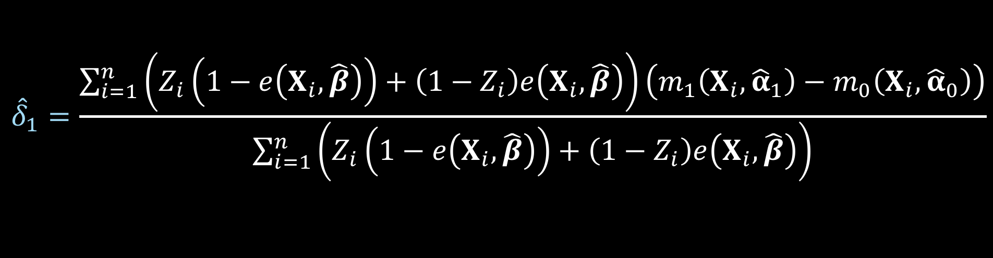
ATO DR estimator
$${\hat{Δ}}_{DR, ATO}={\hat{δ}}_{1}+{\hat{δ}}_{2}−{\hat{δ}}_{3}$$
$${\hat{δ}}_{1}=\frac{\sum_{i=1}^{n}{\left(Z_{i}\left(1−e\left(X_{i},\hat{β}\right)\right)+\left(1−Z_{i}\right)e\left(X_{i},\hat{β}\right)\right)\left(m_{1}\left(X_{i},{\hat{α}}_{1}\right)−m_{0}\left(X_{i}, {\hat{α}}_{0}\right)\right)}}{\sum_{i=1}^{n}{\left(Z_{i}\left(1−e\left(X_{i},\hat{β}\right)\right)+\left(1−Z_{i}\right)e\left(X_{i},\hat{β}\right)\right)}}$$
Notes:
Here is delta 1

Slide 147
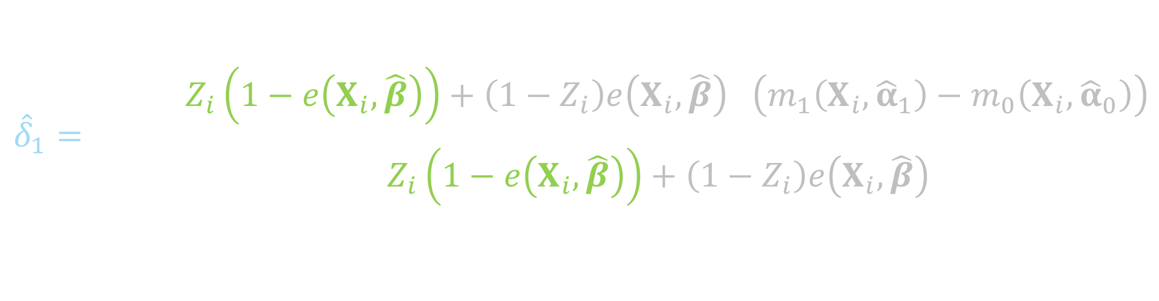
ATO DR estimator
$${\hat{Δ}}_{DR, ATO}={\hat{δ}}_{1}+{\hat{δ}}_{2}−{\hat{δ}}_{3}$$
$${\hat{δ}}_{1}=\frac{\sum_{i=1}^{n}{\left(Z_{i}\left(1−e\left(X_{i},\hat{β}\right)\right)+\left(1−Z_{i}\right)e\left(X_{i},\hat{β}\right)\right)\left(m_{1}\left(X_{i},{\hat{α}}_{1}\right)−m_{0}\left(X_{i}, {\hat{α}}_{0}\right)\right)}}{\sum_{i=1}^{n}{\left(Z_{i}\left(1−e\left(X_{i},\hat{β}\right)\right)+\left(1−Z_{i}\right)e\left(X_{i},\hat{β}\right)\right)}}$$
Notes:
This will be weighted by 1 minus the propensity score for the treated

Slide 148
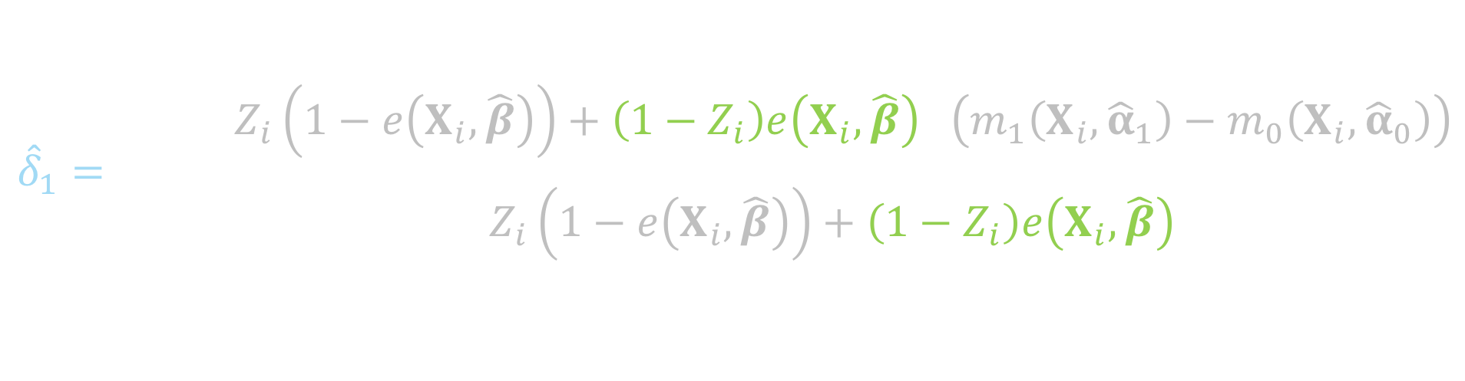
ATO DR estimator
$${\hat{Δ}}_{DR, ATO}={\hat{δ}}_{1}+{\hat{δ}}_{2}−{\hat{δ}}_{3}$$
$${\hat{δ}}_{1}=\frac{\sum_{i=1}^{n}{\left(Z_{i}\left(1−e\left(X_{i},\hat{β}\right)\right)+\left(1−Z_{i}\right)e\left(X_{i},\hat{β}\right)\right)\left(m_{1}\left(X_{i},{\hat{α}}_{1}\right)−m_{0}\left(X_{i}, {\hat{α}}_{0}\right)\right)}}{\sum_{i=1}^{n}{\left(Z_{i}\left(1−e\left(X_{i},\hat{β}\right)\right)+\left(1−Z_{i}\right)e\left(X_{i},\hat{β}\right)\right)}}$$
Notes:
And the propensity score for the controls

Slide 149
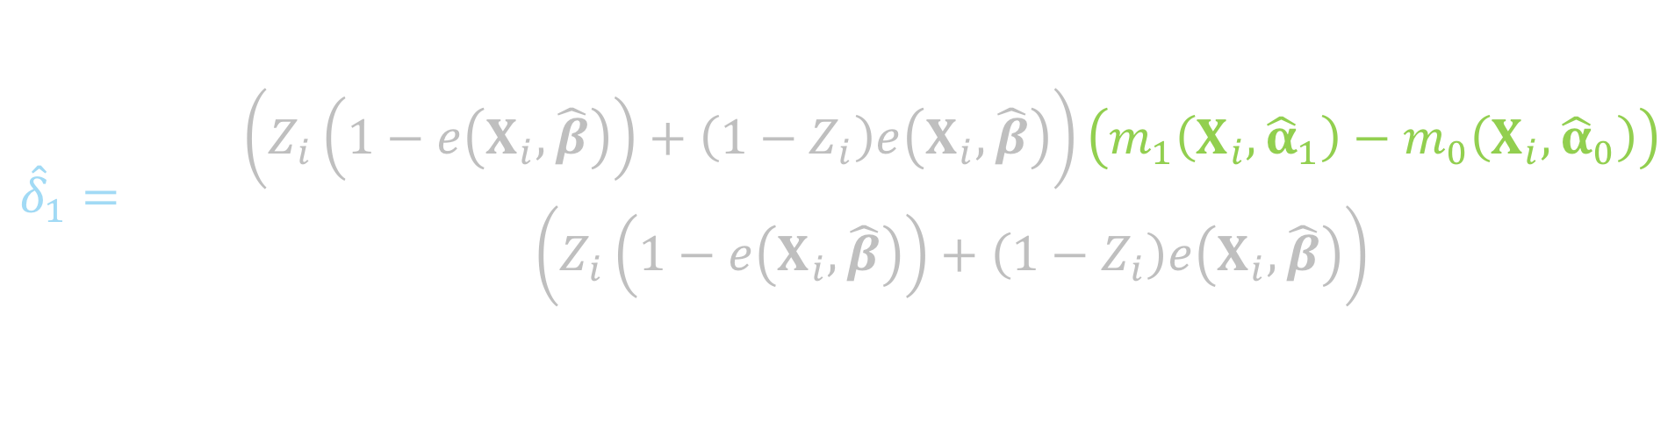
ATO DR estimator
$${\hat{Δ}}_{DR, ATO}={\hat{δ}}_{1}+{\hat{δ}}_{2}−{\hat{δ}}_{3}$$
$${\hat{δ}}_{1}=\frac{\sum_{i=1}^{n}{\left(Z_{i}\left(1−e\left(X_{i},\hat{β}\right)\right)+\left(1−Z_{i}\right)e\left(X_{i},\hat{β}\right)\right)\left(m_{1}\left(X_{i},{\hat{α}}_{1}\right)−m_{0}\left(X_{i}, {\hat{α}}_{0}\right)\right)}}{\sum_{i=1}^{n}{\left(Z_{i}\left(1−e\left(X_{i},\hat{β}\right)\right)+\left(1−Z_{i}\right)e\left(X_{i},\hat{β}\right)\right)}}$$
Notes:
Here is the difference between the Y predicted among the treated and the Y predicted among the controls

Slide 150
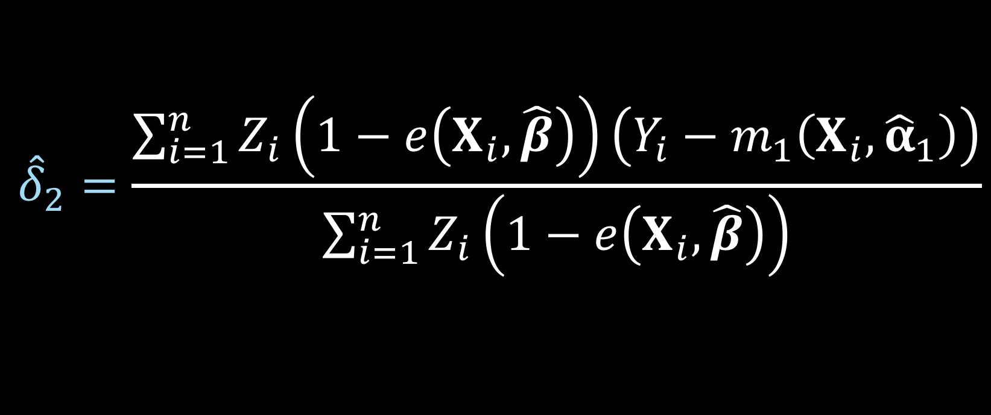
ATO DR estimator
$${\hat{Δ}}_{DR, ATO}={\hat{δ}}_{1}+{\hat{δ}}_{2}−{\hat{δ}}_{3}$$
$${\hat{δ}}_{2}=\frac{\sum_{i=1}^{n}{Z_{i}\left(1−e\left(X_{i},\hat{β}\right)\right)\left(Y_{i}−m_{1}\left(X_{i},{\hat{α}}_{1}\right)\right)}}{\sum_{i=1}^{n}{Z_{i}\left(1−e\left(X_{i},\hat{β}\right)\right)}}$$
Notes:
Here is delta 2

Slide 151
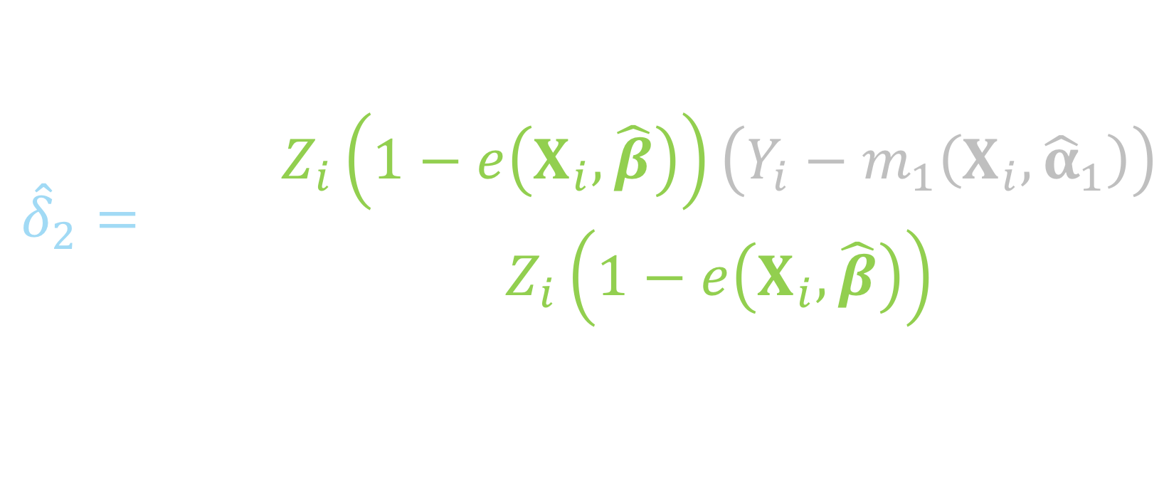
ATO DR estimator
$${\hat{Δ}}_{DR, ATO}={\hat{δ}}_{1}+{\hat{δ}}_{2}−{\hat{δ}}_{3}$$
$${\hat{δ}}_{2}=\frac{\sum_{i=1}^{n}{Z_{i}\left(1−e\left(X_{i},\hat{β}\right)\right)\left(Y_{i}−m_{1}\left(X_{i},{\hat{α}}_{1}\right)\right)}}{\sum_{i=1}^{n}{Z_{i}\left(1−e\left(X_{i},\hat{β}\right)\right)}}$$
Notes:
Notice this is just among the treated, so if the subject i is in the control group, this will be zero, since Zi will be 0

Slide 152
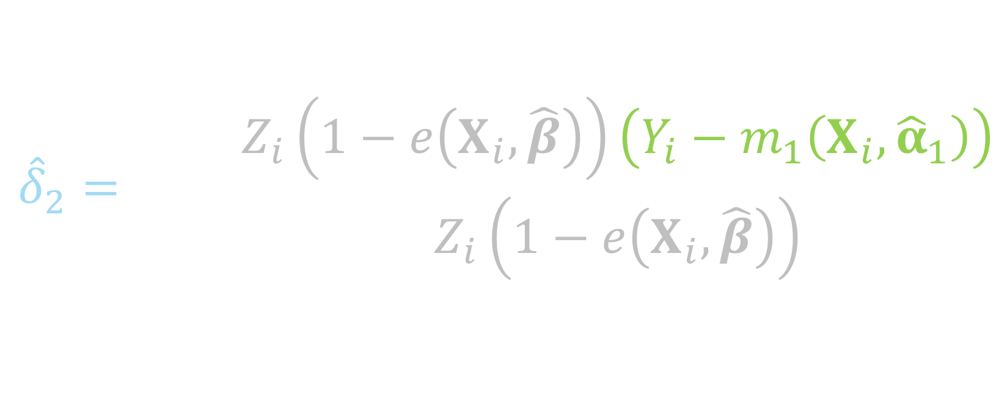
ATO DR estimator
$${\hat{Δ}}_{DR, ATO}={\hat{δ}}_{1}+{\hat{δ}}_{2}−{\hat{δ}}_{3}$$
$${\hat{δ}}_{2}=\frac{\sum_{i=1}^{n}{Z_{i}\left(1−e\left(X_{i},\hat{β}\right)\right)\left(Y_{i}−m_{1}\left(X_{i},{\hat{α}}_{1}\right)\right)}}{\sum_{i=1}^{n}{Z_{i}\left(1−e\left(X_{i},\hat{β}\right)\right)}}$$
Notes:
This piece is essentially the residual between the observed Y among the treated and the predicted Y among the treated

Slide 153
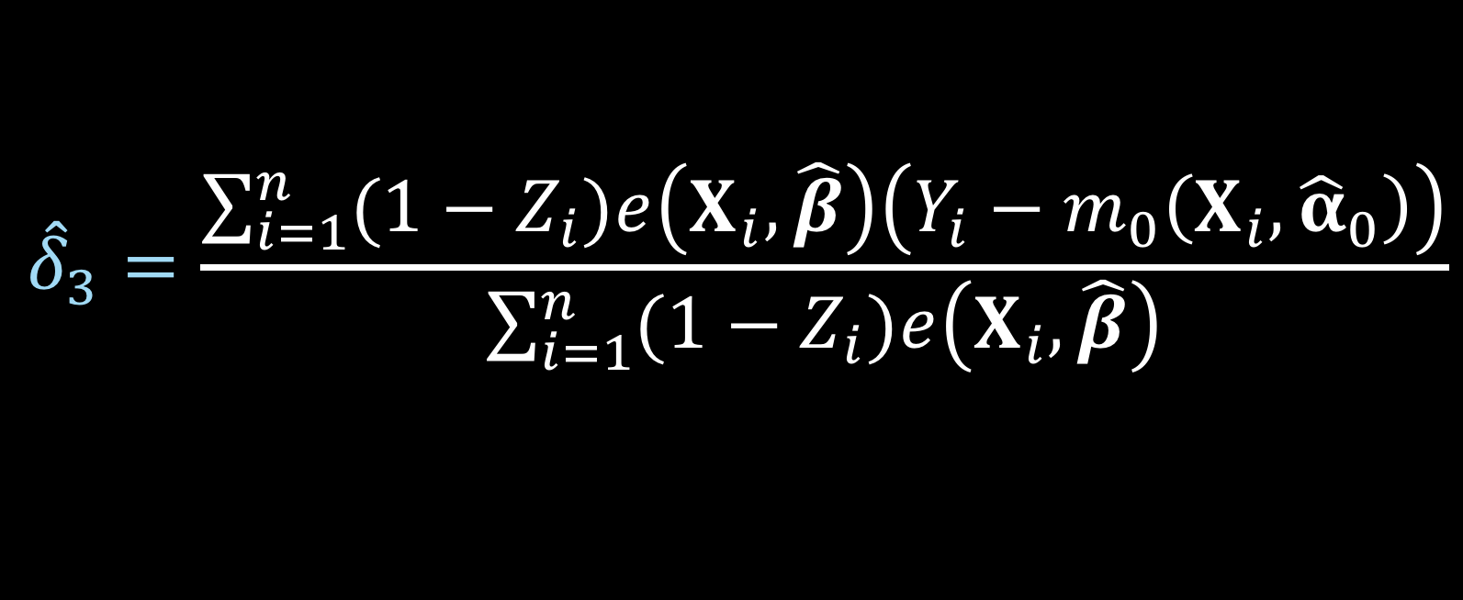
ATO DR estimator
$${\hat{Δ}}_{DR, ATO}={\hat{δ}}_{1}+{\hat{δ}}_{2}−{\hat{δ}}_{3}$$
$${\hat{δ}}_{3}=\frac{\sum_{i=1}^{n}{{(1−Z}_{i})e\left(X_{i},\hat{β}\right)\left(Y_{i}−m_{0}\left(X_{i},{\hat{α}}_{0}\right)\right)}}{\sum_{i=1}^{n}{{(1−Z}_{i})e\left(X_{i},\hat{β}\right)}}$$
Notes:
Here is delta 3

Slide 154
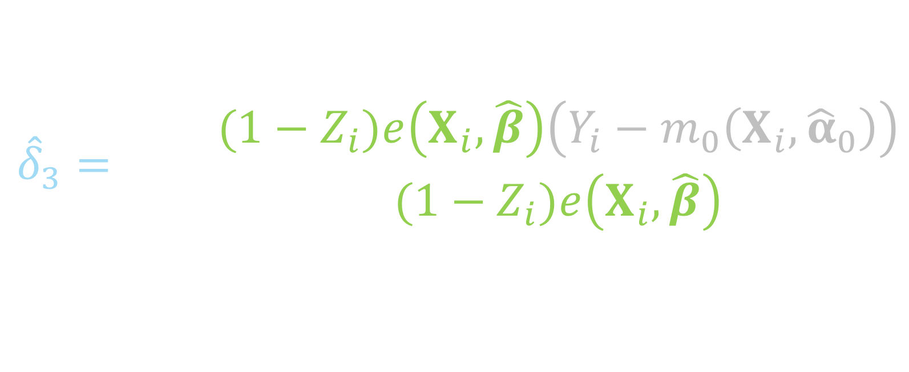
ATO DR estimator
$${\hat{Δ}}_{DR, ATO}={\hat{δ}}_{1}+{\hat{δ}}_{2}−{\hat{δ}}_{3}$$
$${\hat{δ}}_{3}=\frac{\sum_{i=1}^{n}{{(1−Z}_{i})e\left(X_{i},\hat{β}\right)\left(Y_{i}−m_{0}\left(X_{i},{\hat{α}}_{0}\right)\right)}}{\sum_{i=1}^{n}{{(1−Z}_{i})e\left(X_{i},\hat{β}\right)}}$$
Notes:
This summation is just among the controls, if the participant is in the treated group, 1 – Zi will be 0

Slide 155
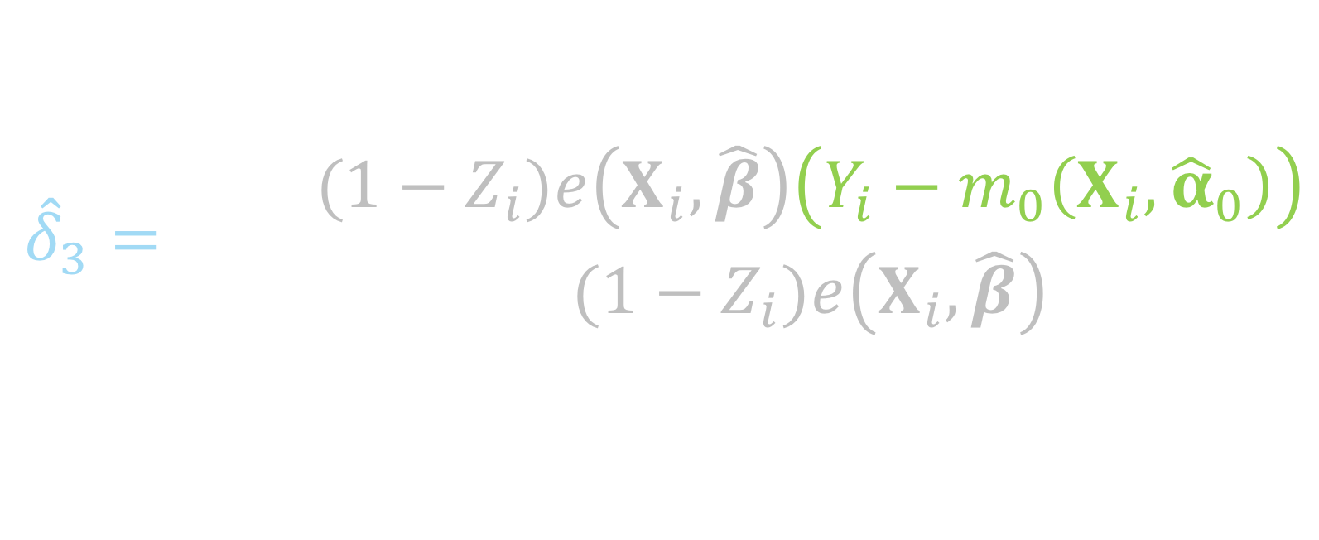
ATO DR estimator
$${\hat{Δ}}_{DR, ATO}={\hat{δ}}_{1}+{\hat{δ}}_{2}−{\hat{δ}}_{3}$$
$${\hat{δ}}_{3}=\frac{\sum_{i=1}^{n}{{(1−Z}_{i})e\left(X_{i},\hat{β}\right)\left(Y_{i}−m_{0}\left(X_{i},{\hat{α}}_{0}\right)\right)}}{\sum_{i=1}^{n}{{(1−Z}_{i})e\left(X_{i},\hat{β}\right)}}$$
Notes:
And this is the residual of the observed y among the controls and the predicted y, fit among the controls

Slide 156

ATO DR estimator
$$u\left(θ\right)=\left(\begin{matrix}(m_{1}\left(X, α_{1}\right)−m_{0}\left(X, α_{0}\right)−δ_{1})(Z\left(1−e\left(X,β\right)\right)+\left(1−Z\right)e\left(X,β\right)) \\ \left(Y−m_{1}\left(X, α_{1}\right)−δ_{2}\right)Z(1−e\left(X,β\right)) \\ \begin{aligned}\left(Y−m_{0}\left(X, α_{0}\right)−δ_{3}\right)\left(1−Z\right)e\left(X, β\right) \\ \left(Y−m_{1}\left(X,α_{1}\right)\right)ZX \\ \left(Y−m_{0}\left(X,α_{0}\right)\right)\left(1−Z\right)X \\ X\left(Z−e\left(X,β\right)\right)\end{aligned}\end{matrix}\right)$$
$$θ={\left(δ_{1}, δ_{2},δ_{3},α_{1}^{T},α_{0}^{T},β^{T}\right)}^{T}$$
Notes:
Again this can be solved by simultaneously solving these estimating equations. Note here that this technically will only be correct if both the outcome model AND the propensity score model are correctly specified.

Slide 157
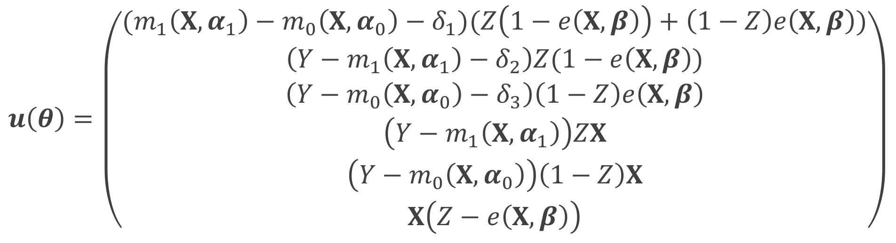
ATO DR estimator
$$u\left(θ\right)=\left(\begin{matrix}(m_{1}\left(X, α_{1}\right)−m_{0}\left(X, α_{0}\right)−δ_{1})(Z\left(1−e\left(X,β\right)\right)+\left(1−Z\right)e\left(X,β\right)) \\ \left(Y−m_{1}\left(X, α_{1}\right)−δ_{2}\right)Z(1−e\left(X,β\right)) \\ \begin{aligned}\left(Y−m_{0}\left(X, α_{0}\right)−δ_{3}\right)\left(1−Z\right)e\left(X, β\right) \\ \left(Y−m_{1}\left(X,α_{1}\right)\right)ZX \\ \left(Y−m_{0}\left(X,α_{0}\right)\right)\left(1−Z\right)X \\ X\left(Z−e\left(X,β\right)\right)\end{aligned}\end{matrix}\right)$$
$$θ={\left(δ_{1}, δ_{2},δ_{3},α_{1}^{T},α_{0}^{T},β^{T}\right)}^{T}$$
Notes:
This is more complicated than the large-sample variance that we derived for the ATO IPW estimator because now we have more parameters to solve for, rather than just mu1, mu0 and beta, we now have delta 1 2 and 3, and alpha 1 and 0 from the outcome models

Slide 158

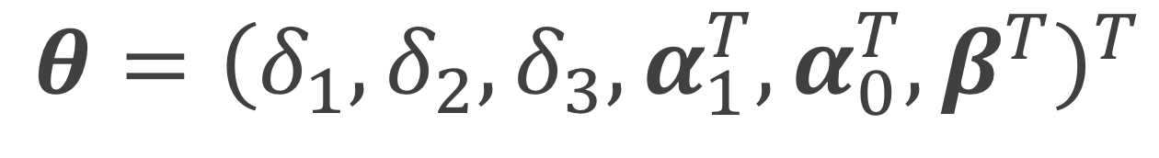
ATO DR estimator
$$u\left(θ\right)=\left(\begin{matrix}(m_{1}\left(X, α_{1}\right)−m_{0}\left(X, α_{0}\right)−δ_{1})(Z\left(1−e\left(X,β\right)\right)+\left(1−Z\right)e\left(X,β\right)) \\ \left(Y−m_{1}\left(X, α_{1}\right)−δ_{2}\right)Z(1−e\left(X,β\right)) \\ \begin{aligned}\left(Y−m_{0}\left(X, α_{0}\right)−δ_{3}\right)\left(1−Z\right)e\left(X, β\right) \\ \left(Y−m_{1}\left(X,α_{1}\right)\right)ZX \\ \left(Y−m_{0}\left(X,α_{0}\right)\right)\left(1−Z\right)X \\ X\left(Z−e\left(X,β\right)\right)\end{aligned}\end{matrix}\right)$$
$$θ={\left(δ_{1}, δ_{2},δ_{3},α_{1}^{T},α_{0}^{T},β^{T}\right)}^{T}$$
Notes:
These first 3 lines are the estimating equations that make up the 3 parts of the doubly robust equation we just went through

Slide 159
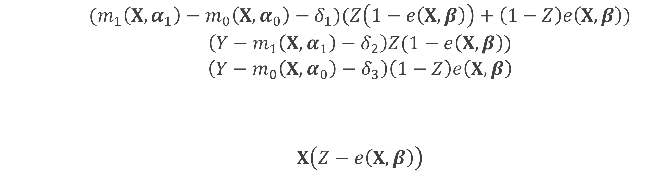
ATO DR estimator
$$u\left(θ\right)=\left(\begin{matrix}(m_{1}\left(X, α_{1}\right)−m_{0}\left(X, α_{0}\right)−δ_{1})(Z\left(1−e\left(X,β\right)\right)+\left(1−Z\right)e\left(X,β\right)) \\ \left(Y−m_{1}\left(X, α_{1}\right)−δ_{2}\right)Z(1−e\left(X,β\right)) \\ \begin{aligned}\left(Y−m_{0}\left(X, α_{0}\right)−δ_{3}\right)\left(1−Z\right)e\left(X, β\right) \\ \left(Y−m_{1}\left(X,α_{1}\right)\right)ZX \\ \left(Y−m_{0}\left(X,α_{0}\right)\right)\left(1−Z\right)X \\ X\left(Z−e\left(X,β\right)\right)\end{aligned}\end{matrix}\right)$$
$$θ={\left(δ_{1}, δ_{2},δ_{3},α_{1}^{T},α_{0}^{T},β^{T}\right)}^{T}$$
Notes:
These two are the estimating equations for fitting the outcome models, the top is for the outcome model among the treated, the bottom is the outcome model among the controls

Slide 160
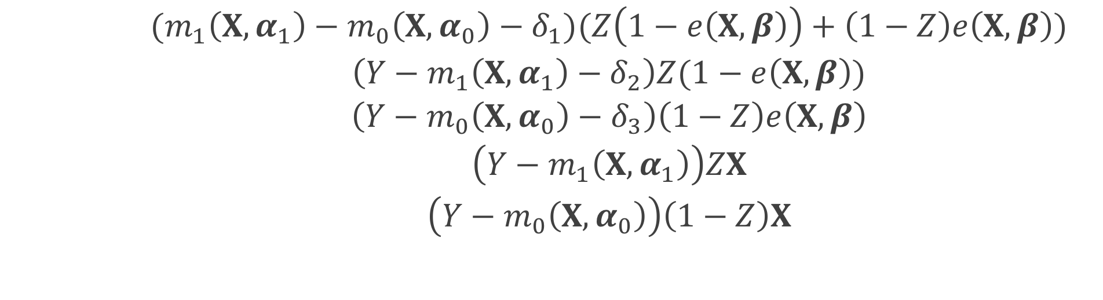
ATO DR estimator
$$u\left(θ\right)=\left(\begin{matrix}(m_{1}\left(X, α_{1}\right)−m_{0}\left(X, α_{0}\right)−δ_{1})(Z\left(1−e\left(X,β\right)\right)+\left(1−Z\right)e\left(X,β\right)) \\ \left(Y−m_{1}\left(X, α_{1}\right)−δ_{2}\right)Z(1−e\left(X,β\right)) \\ \begin{aligned}\left(Y−m_{0}\left(X, α_{0}\right)−δ_{3}\right)\left(1−Z\right)e\left(X, β\right) \\ \left(Y−m_{1}\left(X,α_{1}\right)\right)ZX \\ \left(Y−m_{0}\left(X,α_{0}\right)\right)\left(1−Z\right)X \\ X\left(Z−e\left(X,β\right)\right)\end{aligned}\end{matrix}\right)$$
$$θ={\left(δ_{1}, δ_{2},δ_{3},α_{1}^{T},α_{0}^{T},β^{T}\right)}^{T}$$
Notes:
This final equation accounts for the propensity score model

Slide 161
ATO estimator
$$0=\sum_{i=1}^{n}{u_{i}\left(θ\right)}$$
$$θ={\left(δ_{1}, δ_{2},δ_{3},α_{1}^{T},α_{0}^{T},β^{T}\right)}^{T}$$
Notes:
we can estimate the propensity score and the treatment effect simultaneously in one step by solving the following estimating equations with respect to theta

Slide 162
M-Estimation
$$\sqrt{n}\left(\hat{θ}−θ\right)\underset{→}{d}N(0, A^{−1}BA^{−T})$$
Notes:
Since these estimating equations are unbiased, U of theta is an example of an M-estimator. The asymptotic distribution of an M estimator is the following.
the negative T is just inverse transpose

Slide 163
Sandwich estimator
$$A^{−1}BA^{−T}$$

Slide 164
Sandwich estimator
$$A^{−1}BA^{−T}$$
$$A=−E\left[\frac{∂u\left(θ\right)}{∂θ}\right]$$
Notes:
A is the model-based estimate, B is the “robust” estimate of the information (the variance of the score function)

Slide 165
Sandwich estimator
$$A^{−1}BA^{−T}$$
$B=E\left[u\left(θ\right)u{\left(θ\right)}^{T}\right]$

Slide 166
Sandwich estimator
$$\hat{var}\left(\hat{θ}\right)=\frac{1}{n}{{\hat{A}}_{n}}^{−1}{\hat{B}}_{n}{{\hat{A}}_{n}}^{−T}$$
Notes:
We can replace the expectations by the sample average to get an approximate large sample variance

Slide 167
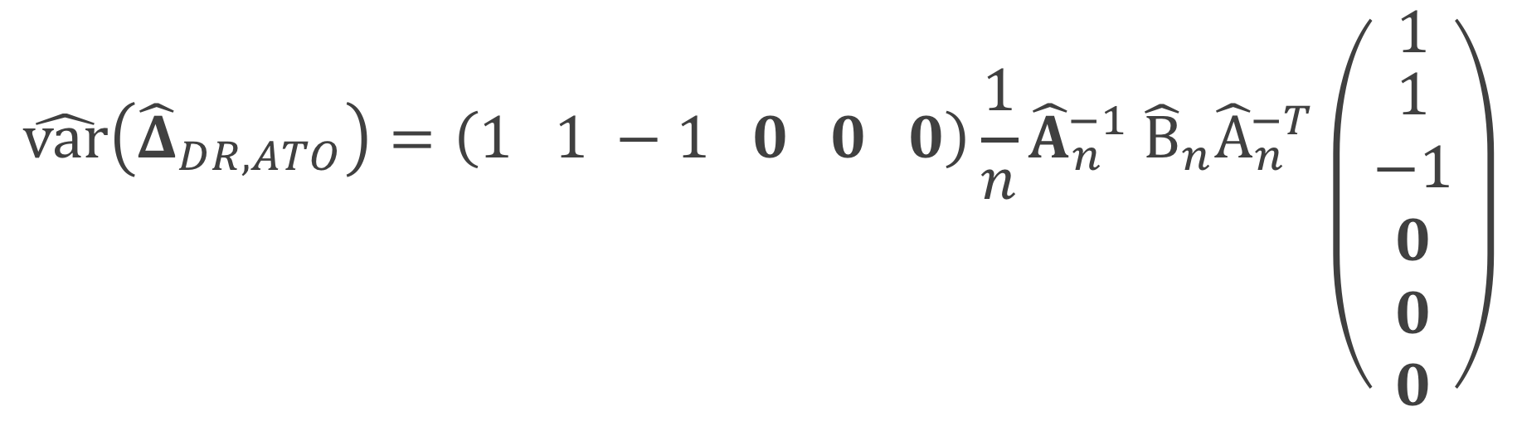
ATO DR estimator
$${\hat{Δ}}_{DR, ATO}={\hat{δ}}_{1}+{\hat{δ}}_{2}−{\hat{δ}}_{3}$$
$$\hat{var}\left({\hat{Δ}}_{DR, ATO}\right)=\left(1 1 −1 0 0 0\right){\frac{1}{n}\hat{A}}_{n}^{−1} {\hat{B}}_{n}{\hat{A}}_{n}^{−T}\left({1 \atop \begin{aligned}1 \\ −1 \\ 0 \\ 0 \\ 0\end{aligned}}\right)$$
Notes:
Because we are estimating delta 1 plus delta 2 minus delta 3, after we estimate our sandwich estimator

Slide 168

ATO DR estimator
$${\hat{Δ}}_{DR, ATO}={\hat{δ}}_{1}+{\hat{δ}}_{2}−{\hat{δ}}_{3}$$
$$\hat{var}\left({\hat{Δ}}_{DR, ATO}\right)=\left(1 1 −1 0 0 0\right){\frac{1}{n}\hat{A}}_{n}^{−1} {\hat{B}}_{n}{\hat{A}}_{n}^{−T}\left({1 \atop \begin{aligned}1 \\ −1 \\ 0 \\ 0 \\ 0\end{aligned}}\right)$$
Notes:
This will be our variance estimator where

Slide 169
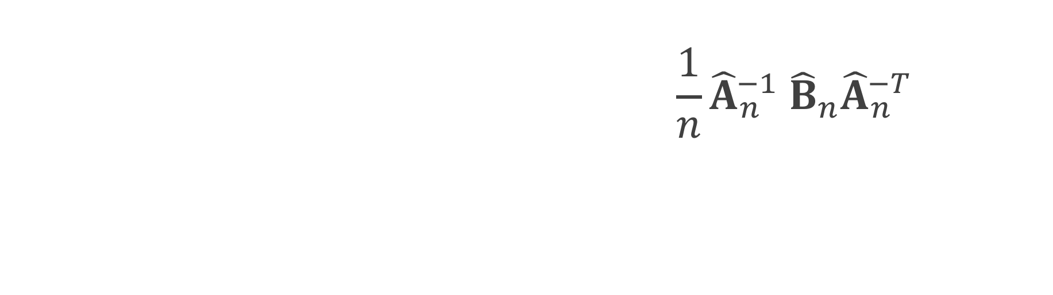
ATO DR estimator
$${\hat{Δ}}_{DR, ATO}={\hat{δ}}_{1}+{\hat{δ}}_{2}−{\hat{δ}}_{3}$$
$$\hat{var}\left({\hat{Δ}}_{DR, ATO}\right)=\left(1 1 −1 0 0 0\right){\frac{1}{n}\hat{A}}_{n}^{−1} {\hat{B}}_{n}{\hat{A}}_{n}^{−T}\left({1 \atop \begin{aligned}1 \\ −1 \\ 0 \\ 0 \\ 0\end{aligned}}\right)$$
Notes:
We will multiply by the vector 1 1 -1 with the remaining entries 0 on both sides

Slide 170
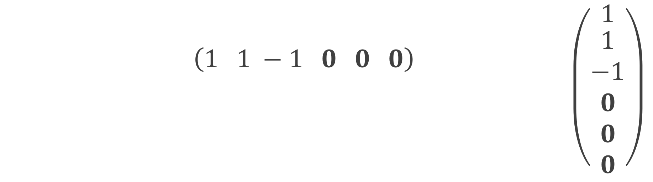
ATO DR estimator
$${\hat{Δ}}_{DR, ATO}={\hat{δ}}_{1}+{\hat{δ}}_{2}−{\hat{δ}}_{3}$$
$$\hat{var}\left({\hat{Δ}}_{DR, ATO}\right)=\left(1 1 −1 0 0 0\right){\frac{1}{n}\hat{A}}_{n}^{−1} {\hat{B}}_{n}{\hat{A}}_{n}^{−T}\left({1 \atop \begin{aligned}1 \\ −1 \\ 0 \\ 0 \\ 0\end{aligned}}\right)$$
Notes:
We multiply by our estimated sandwich estimator where we've plugged in our sample averages for the expectations

